Slide 1
Powering Jobs Census 2019:
The Energy Access Workforce
July 12, 2019
powerforall.org/poweringjobs
#PoweringJobs

Slide 2
Putting energy access to work
Up to 20,000 decentralized renewable energy (DRE) companies are needed to power SDG 7 by 2030.
The off-grid value chain could create 4.5 million jobs globally by 2030 – including sales, installation, service, appliances.
The majority of renewable energy jobs are outside of low energy access countries (just 1 percent in Africa of global 11 million).
There is a dearth of workforce with the technical, financial and managerial skills needed for DRE in low energy access countries.
The global community must develop knowledge and interest in DRE sector, along with technical and vocational training (TVET), to create the workforce needed — or we will be unable to power SDGs.

Slide 3
Research Scope – Technology
The first jobs survey of the decentralized renewable energy (DRE) sector, covering 5 types of technologies

Slide 4
Research Scope – Job Types
Job estimates and projections cover direct formal, informal jobs
Productive use jobs estimates are covered by expert and literature inputs
Indirect jobs and induced jobs are not covered in job estimates or projections

Slide 5
Key Findings

Slide 6
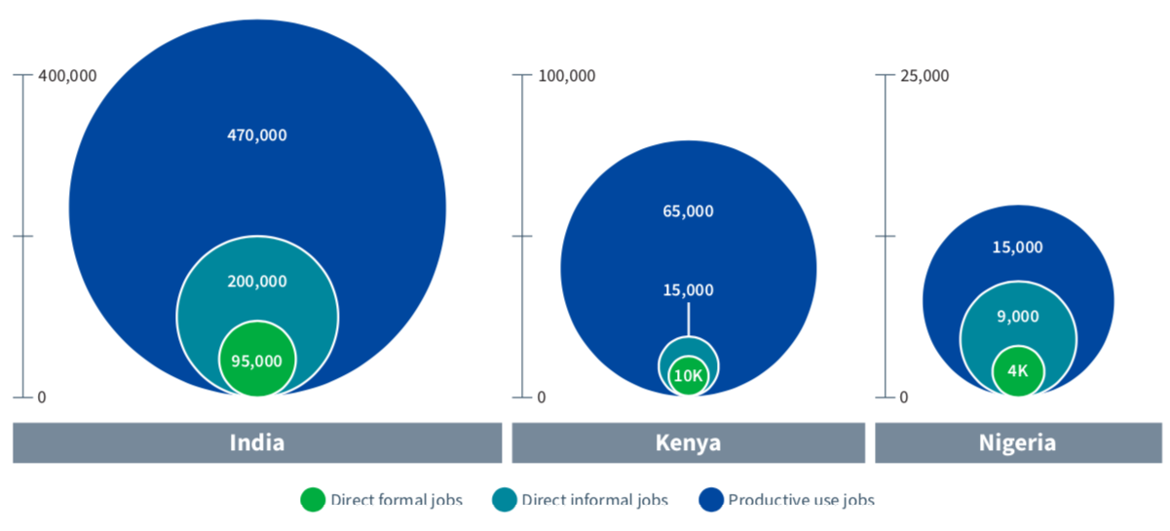
Jobs Estimate in 2017–18
The scale of DRE direct formal workforce is already on the order of traditional power sector or utility-scale solar
In addition to direct formal jobs, the DRE sector employs 2x–5x more people through indirect jobs and productive use jobs
Direct formal jobs
Direct informal jobs
Productive use jobs

Slide 7
Jobs Projection in 2022–23
DRE direct formal jobs will about double in India and Kenya, and grow by tenfold in Nigeria
Informal jobs may grow, but not as fast as direct formal jobs
50,000
100,000
200,000
52,000
30,000
180,000
17,000
24,000
Direct formal jobs
Direct informal jobs

Slide 8
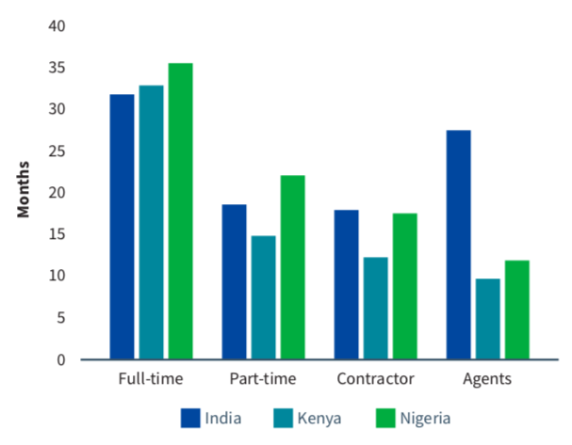
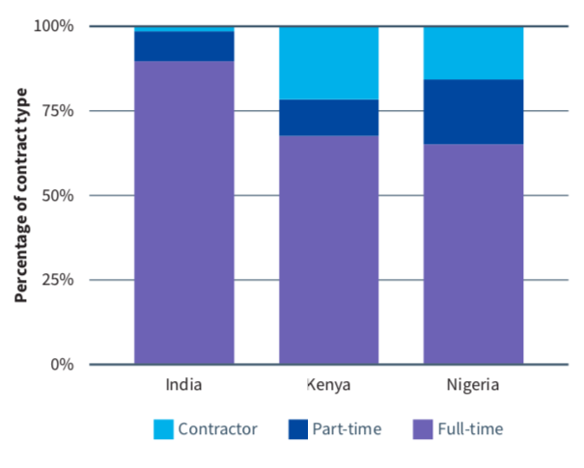
Job Permanence
The DRE sector provides full-time, middle-income, long-term jobs. Average retention is more than 30 months across the board and the majority of direct formal jobs are full-time jobs.
Average Retention in Months
Level of Engagement

Slide 9
Job Functions Breakdown in 2017–18
In India and Kenya, approximately 40% of the jobs are in sales and distribution
In Nigeria, project development and installation makes up a large part of the workforce
In all three countries, management and business administration is an important part of the workforce

Slide 10
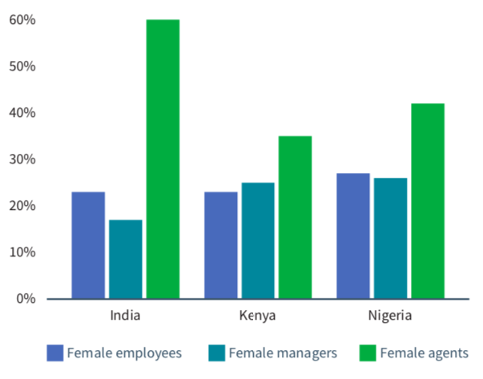
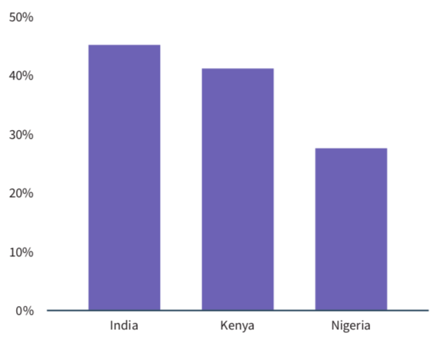
Women and Youth
Just 1/4 of the direct formal jobs are occupied by women, as compared to 32% for the global renewable energy sector. Women constitute higher percentage of the informal workforce.
Youth participation is high. Companies express strong interest in hiring young people.
Women Participation
Youth Participation

