Slide 1



Side event on “Interlinkages between SDG 7 (energy) and SDGs 4, 8, 10, 13, 16”
16.15-17.45, Friday, 12 July 2019
S1522-S1523, UNHQ
“Inter-related SDG 7 and SDG 4, 8, 10, 13, 16:
challenges and prospects in the ESCWA region”
Roula Majdalani
Director, Sustainable Development Policies Division (SDPD),
UNESCWA
majdalani@un.org

Slide 2





SDG 7: affordable and clean energy in relation with other SDGs
7.1 By 2030, ensure universal access to affordable, reliable and modern energy services
7.2 By 2030, increase substantially the share of renewable energy in the global energy mix
7.3 By 2030, double the global rate of improvement in energy efficiency
Interlinkages between SDG7 and SDGs 4, 8, 10, 13 &16 through a RBA
Capacity building skills for low-carbon future.
Low-Carbon education institutions
New jobs and skills with adoption of new energy technologies
Energy efficiency & distributed renewable energy deliver lower cost access wellbeing and economic services
Direct reductions in GHGs from renewable energy and energy efficiency
Redeveloped energy systems and institutions to deliver sustainability and SGD outcomes

Slide 3
Arab region key challenges: facts on the ground
Natural resources unequally distributed
High vulnerability to climate change
Water scarcity
Land degradation
Food insecurity
High dependency on fossil fuel
Increasing vulnerability to international energy price fluctuations
Subsidized prices for energy, electricity and water
Limited access to finance and technology
Armed conflict, regional instability and mass migration
Undeveloped rural areas, mostly in the least developed countries
Rising urbanization and unequal access to modern energy and basic services (education, healthcare, drinking water, decent jobs ...) are exacerbating the urban-rural divide
Inclusive and integrated approach for natural resource management and to build resilience to climate change

Slide 4
KEY FACTS IN NUMBERS – Are we on track in the ARAB REGION?
Near-universal access to modern energy but very slow progress in energy efficiency and a marginal role of renewable energy
Electrification
92.5 per cent in the Arab region is electrified.
30 million still remain without electricity access. Mainly in three LDCs with only 50% deficit in rural.
Clean cooking
Access to CFTs is encouragingly high in the Arab region with 90.3% in 2017.
37.5 million people still lack access to CFTs, mainly in rural LDCs and conflict areas.
Renewables
RE share has been plateauing at around 10.2% of the region total final energy consumption since 2010,
The share of Solar, Wind and hydro power lies at only 19% of the region’s RE total.
Efficiency
2nd lowest energy intensity of the world’s regions, largely an artefact of its fuel mix based on widespread efficient use of gas.
Transport remains by far the most energy-intensive sector, followed by industry and agriculture.

Slide 5

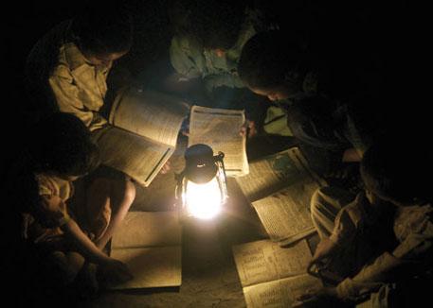
Lack of secure, clean and affordable energy holds many dire consequences on access to basic health services, education, sanitation, and ultimately economic opportunities.
Arab region’s electrification access-deficit in population numbers (mn)
The unparalleled escalation of conflict and instability in Iraq, Libya, Syria and Yemen since 2014 has had devastating effects on energy access in the Arab region.

Slide 6
ESCWA Regional Initiative for Promoting Small-Scale Renewable Energy Applications in rural areas of the Arab Region
DRIVER
INCLUSIVE , SUSTAINABLE, ENVIRNMENTAL AND ECONOMIC REVIVAL & DEVELOPMENT OF THE ARAB RURAL COMMUNITIES
RE Technologies
Effective/innovative RE-Small scale decentralized and modular, energy systems.
Water-Energy-Food nexus
Access to productive resources, appropriate and reliable services.
Human Capacity
Model based on knowhow
Trainings, Knowledge skills/Advisory Services.
Brining change among rural community from resource poor living standards to reliable, affordable and modern sources of energy.
Women’s Empowerment & Social inclusion
Economic power in rural women’s hands
Female mentor
Participative and bottom-up approach
Entrepreneurial development
Economic transformation, Environmental and socio-economic development priorities
Entrepreneurial jobs in productive sectors
Spawn energy-based enterprises around RE based service providers
Policy and institutional Framework
Pro-poor investments and private sector involvement
Synergies among national/regional stakeholders.
Innovative incentive mechanisms.
PILLARDS
Cross Cutting
Human Rights, Gender equality, resilience to Climate Change
FONDATION
Untapped RE Resource, high Unemployment, chronic poverty, water scarcity, food insecurity, energy poverty and vulnerability to climate change of the rural communities of the Arab countries

Slide 7
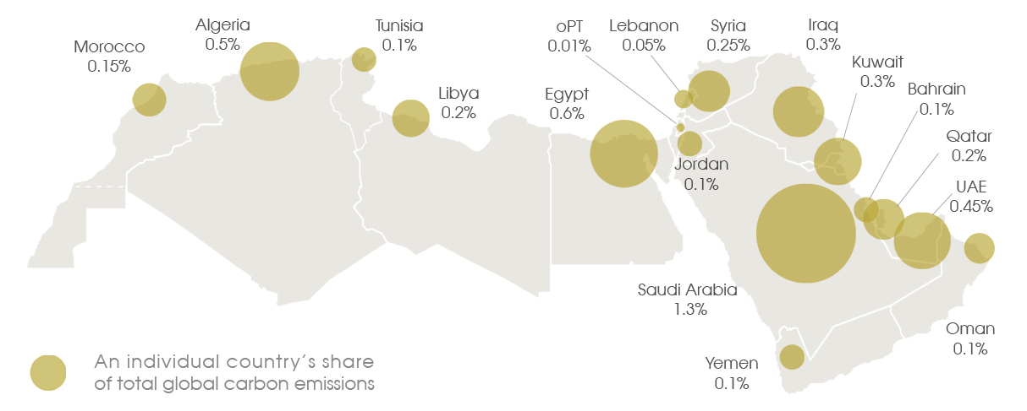
While climate change has not in the past played a significant role in Arab countries’ discourse on energy use, ……..today the Arab region is one of the regions of the world most vulnerable to climate change
Copyrights: Carboun 2017
Historically low rate of energy use and carbon emissions: Arab region constitutes 5% of the world’s population, emits just under 5% of global carbon emissions

Slide 8
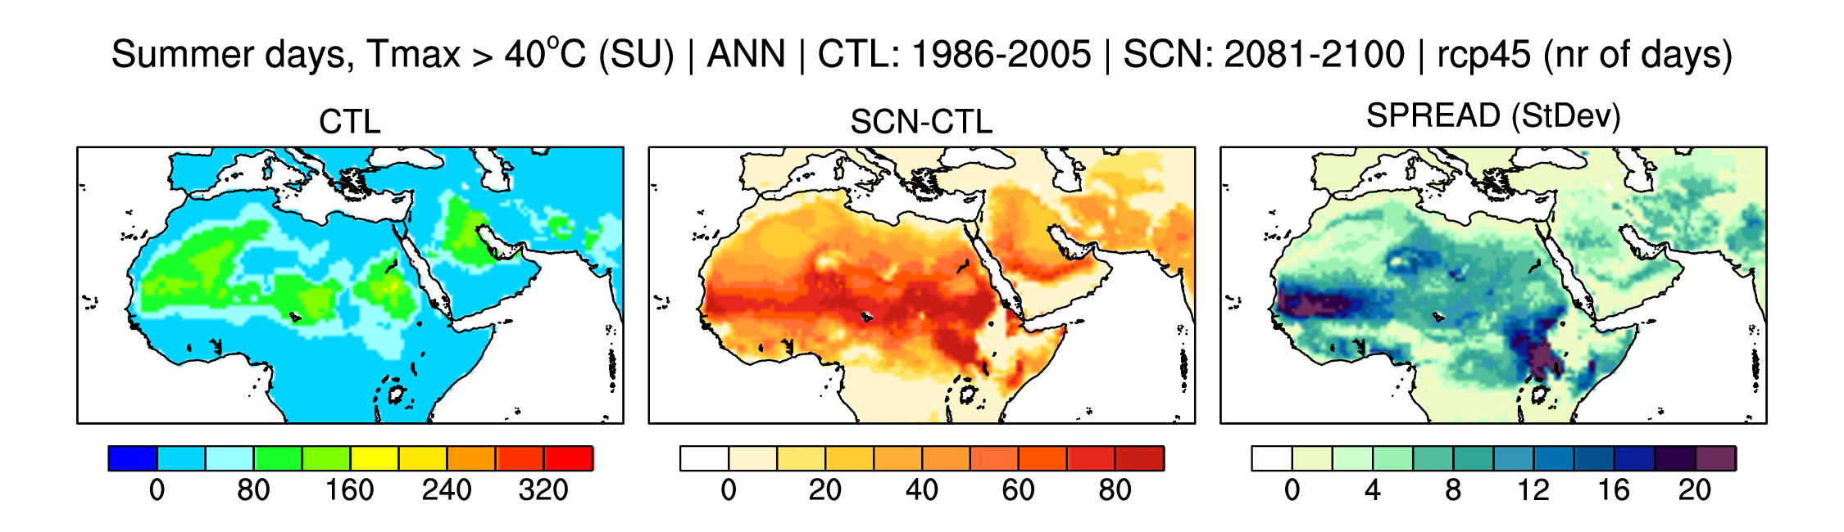
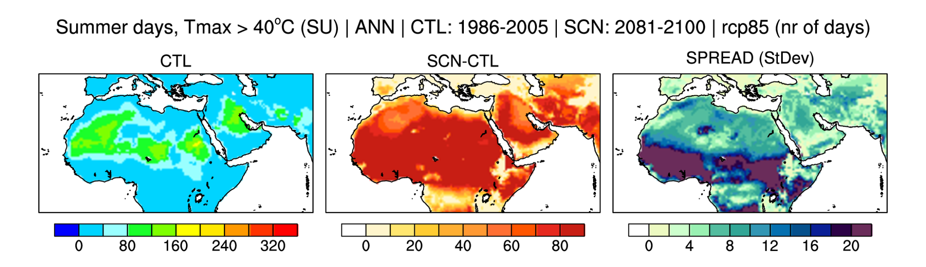
Extreme Climate Indices
Changes in Temperature Indices – Summer Days >40
Changes in the Summer days with Tmax > 40°C (i.e. annual number of days when Tmax >40°C) for the period 2081-2100 for RCP 4.5 and RCP 8.5 compared to the baseline period 1986-2005 for the ensemble of the three projections.
The results show strong warming in the Sahara and Central Peninsula Areas for RCP8.5. The increase in the extreme temperature on the coastal areas would be lower than the central parts of the region for both scenarios.

Slide 9
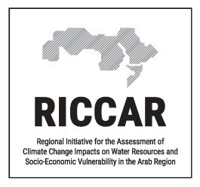
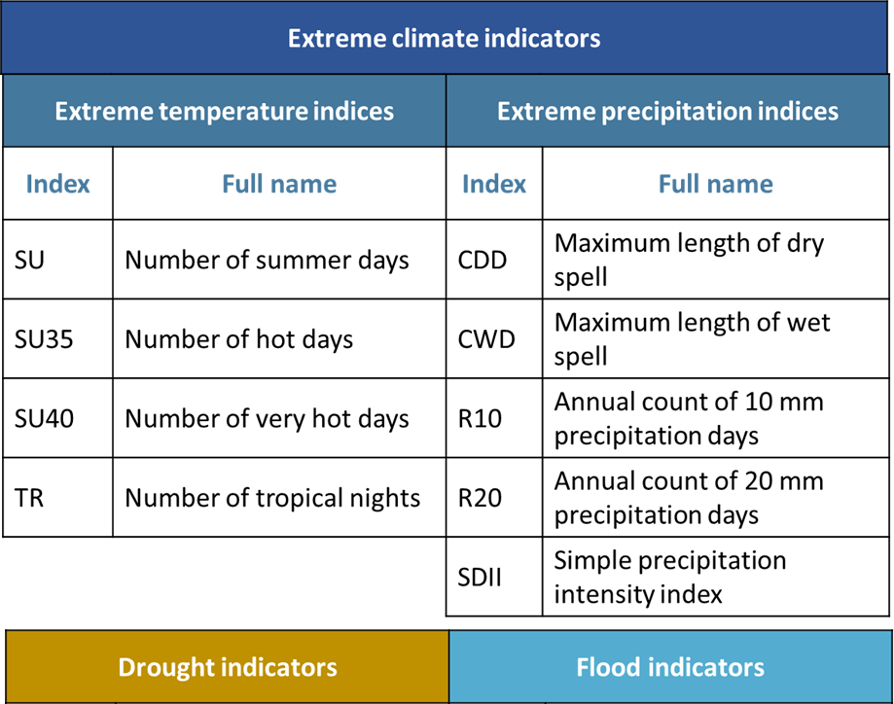
Extreme Climate Indices and Disaster Risk Reduction
Extreme weather events can have severe impacts on human health, built infrastructure, the natural environment, the transportation sector and the economy at large.
Extreme climate indices and their seasonal projections can provide a better understanding of climate impacts and can help to inform action for reducing disaster risks at smaller scales of analysis.
Future projections for several extreme climate indices were studied under RICCAR until the end of the century for different GHG emission scenarios (RCP4.5 moderate scenario, RCP8.5 high emissions scenario) in the Arab region
Floods in Gaza, 2011
Damages in Muscat after Cyclone Gonu, 2007

Slide 10
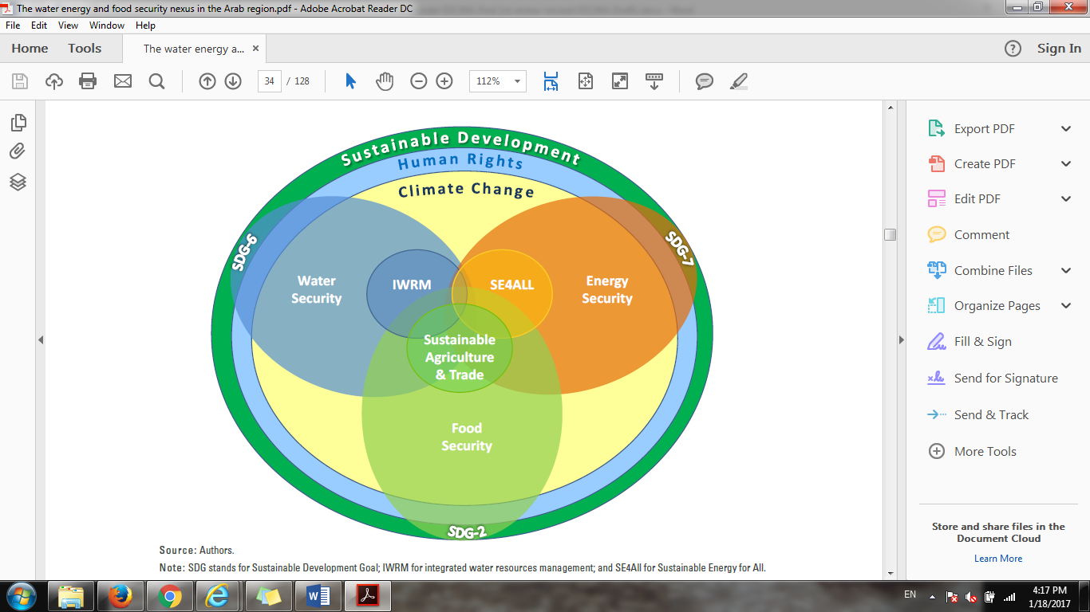
ESCWA Framework for the Water-energy nexus within the context of the 2030 Agenda for sustainable development
Inclusive national development pursuing policies that embrace the principles of universality and inclusivity

Slide 11


ESCWA
Core Functions
Scale up actions in support of SDG7 achievement and intensify engagement through support to VNRs and other outreach platforms.
Vehicle the priorities of the region to the global level through the: HLPF, Regional and International Forums, TAG SDG7, UN-Energy.
Partner with SDG7 Custodian agencies on the SDG7 Global Report and develop the “SDG7 Tracking Report for the Arab Region.
Develop Knowledge exchange platform through ESCWA Committee on Energy and the ESCWA Expert Group on Fossil Fuels.
Develop Regional initiatives and projects on upscaling EE and promoting use of RE and trainings on tracking SDG7 indicators.
Establish jointly with SEforAll and IsDB the SEforAll Middle East Hub.
Implement field projects through an integrated approach that address natural resource management, reduce inequality, address climate change challenges.
To serve as the:
Think Tank of the Arab region – by undertaking innovative research and supporting quality data collection and analysis for evidence-based policy;
Advisor to the Arab region – by providing regional, sub-regional and national capacity building and technical advisory services to member States; and
Voice of the Arab region – by creating regional platforms for deliberation and consensus building that feed global fora and transform the aspirations of Arab citizens into commitments for action.

Slide 12
Key Policy Recommendations from the ESCWA preparatory meetings on energy, water and climate change for 2018 – 2019 AFSD and HLPF:
Priority Actions
Develop suitable/proactive policies & institutional frameworks and ensure long term commitment
Reform domestic energy and water pricing and utility market
Manage natural resources more sustainably
Boost economic diversification & boost energy productivity
Increase private sector involvement
Develop local manufacturing of clean energy technologies components
Enhance interregional cooperation, grid interconnection and share/learn from best practices.
Develop institutional capacity, transparency and accountability
Strengthen local governance and communication
Reinforce the role of Civil Society, Gender equality and stakeholder engagement.
Means of Implementation
Promote investments in clean technologies / financial market & local market enablement
Develop/reinforce technology dissemination & Research and Innovation
Initiate/ reinforce capacity building programs
Develop/reinforce energy data, indicators and analysis systems

Slide 13
THANK YOU

