Slide 1
The Merging of Knowledge A deeply participatory approach Dr Rachel Bray Research Associate Department of Social Policy and Intervention University of Oxford
2019 High-Level Political Forum – Side event

Slide 2
Why did we choose the Merging of Knowledge?
SDG Target 1.2 to halve poverty in all its dimensions
But what are the dimensions of poverty and who should decide them?
We set out to design research that
prioritises the knowledge of people experiencing poverty
merges this with the knowledge of practitioners and of academics/decision-makers

Slide 3
What is the Merging of Knowledge and how does it work?
An approach to research and practice, founded on principles
Full citizenship for all; every person’s knowledge counts
Guaranteed equality; addresses inherent power dynamics
Based on the idea that our knowledge derives from our lived experience
Direct experience of poverty Professional practice Academic research
Steered by a team of co-researchers from all backgrounds (half living in poverty)
Follows steps:
Work in peer groups (20 - 30 hours)
Synthesis of conclusions from each knowledge group (by steering team)
Collective analysis by representatives from all three groups (3 - 10 days)

Slide 4
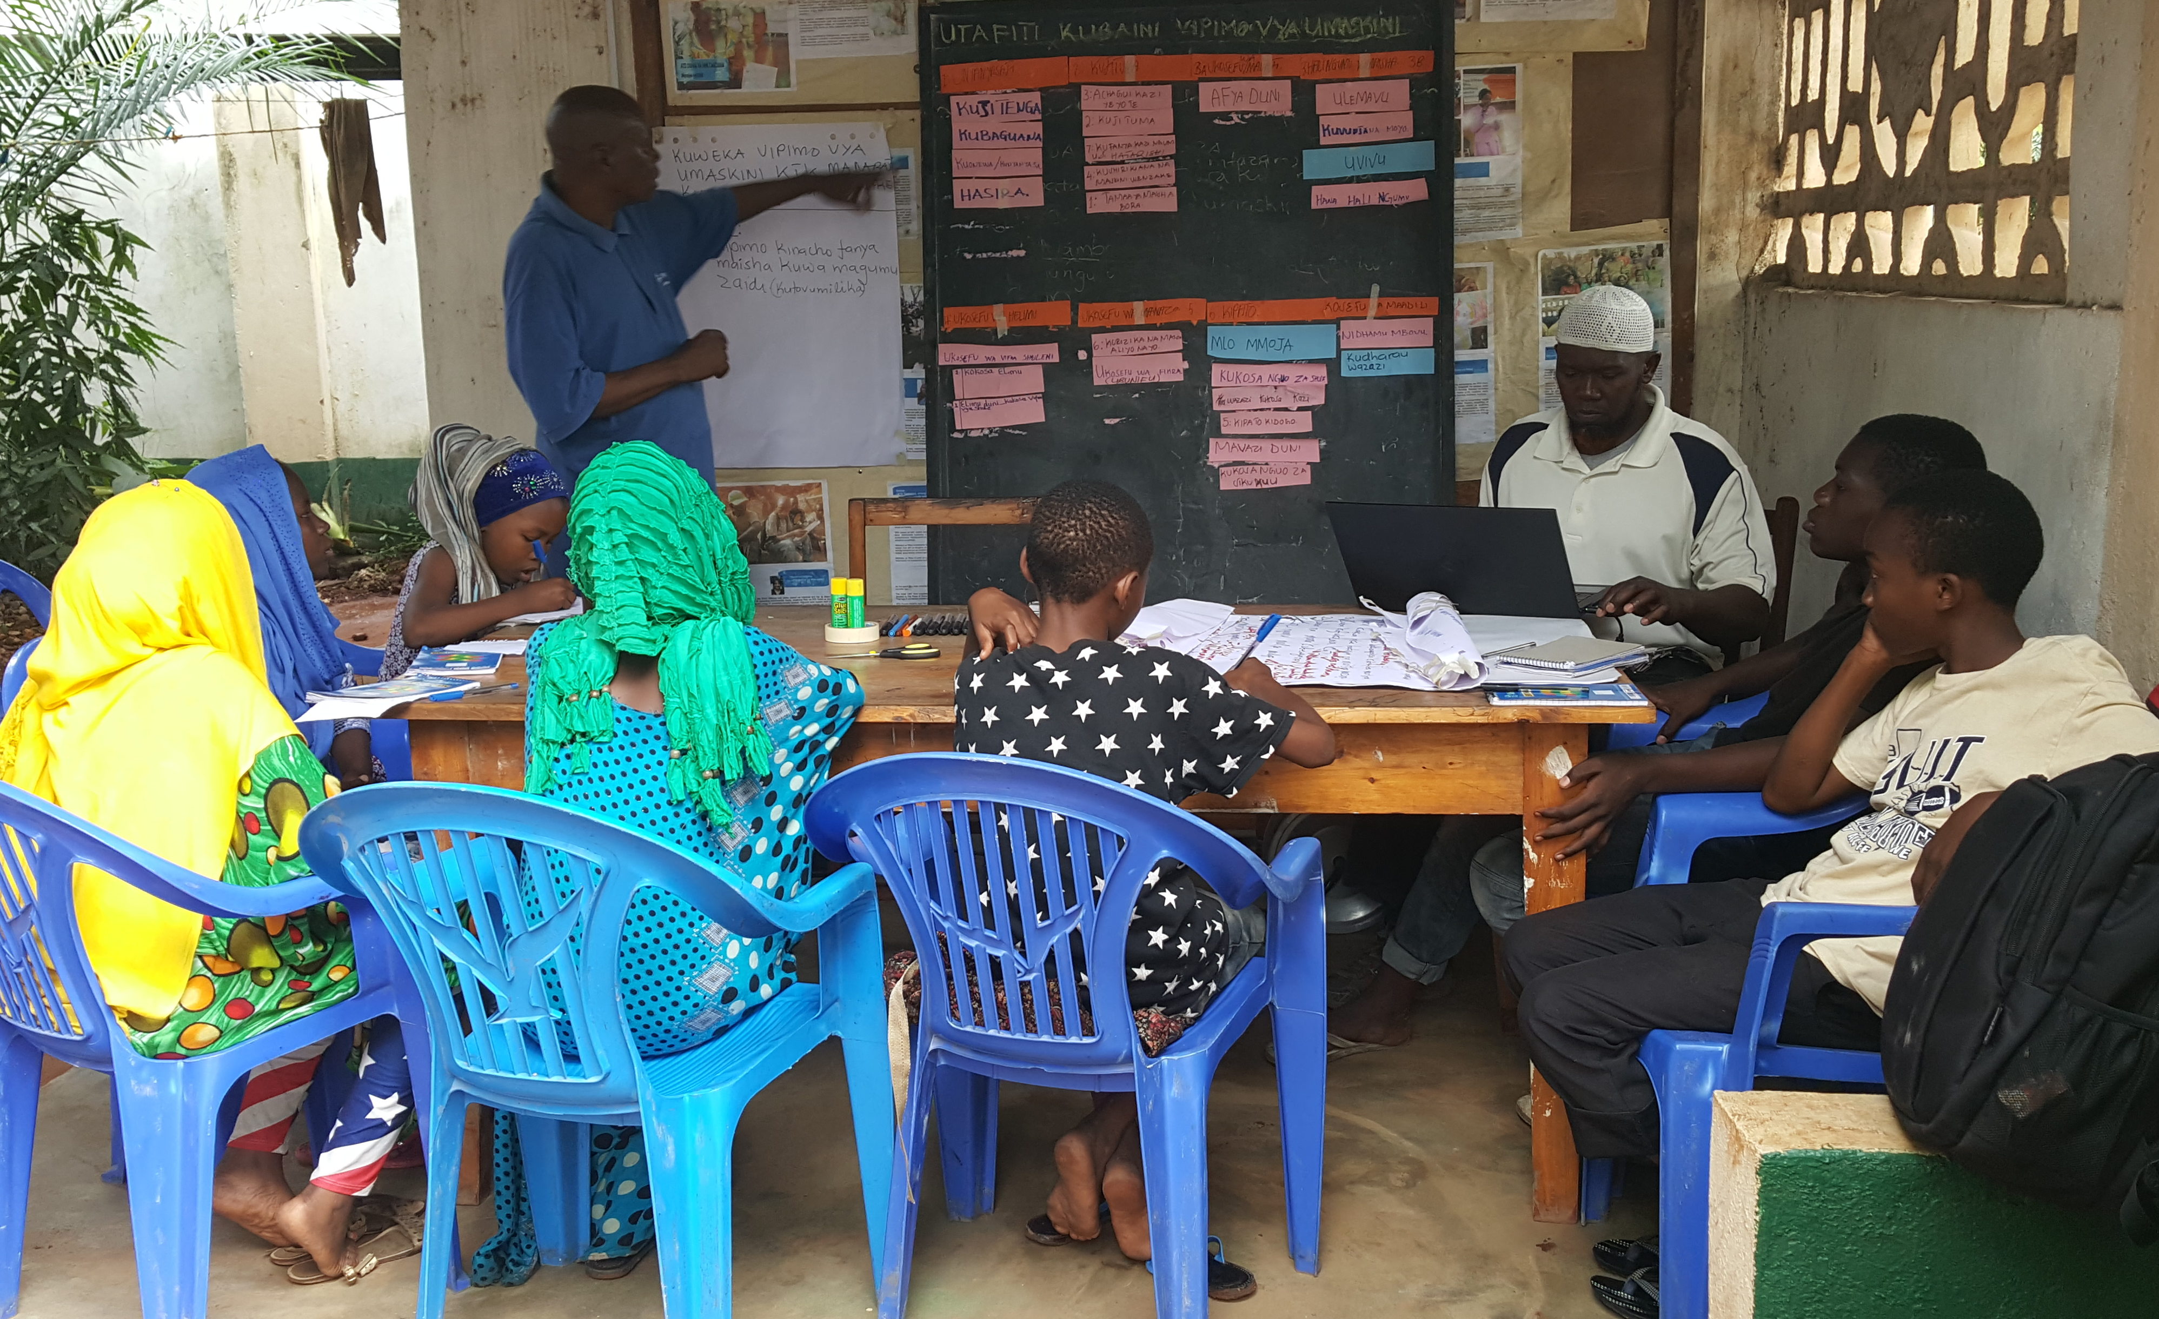
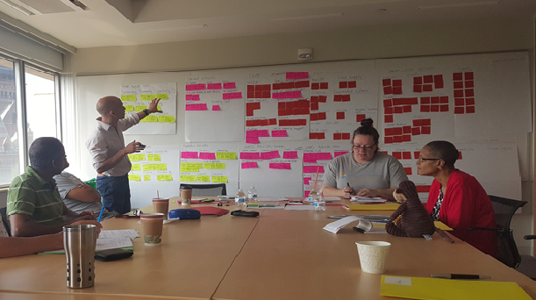
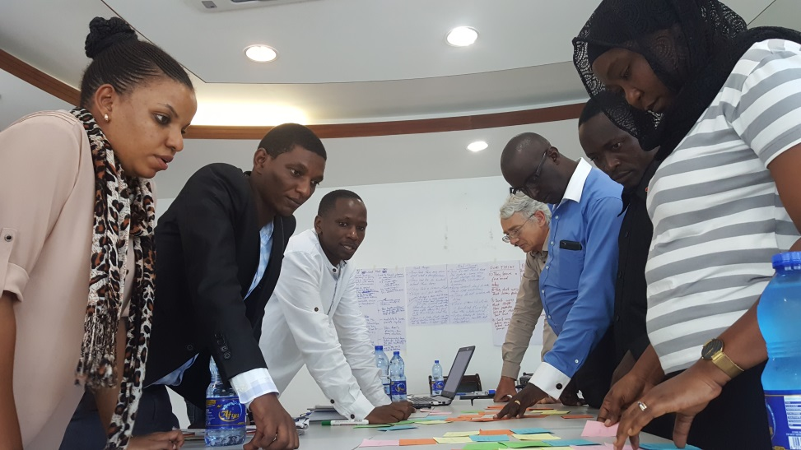
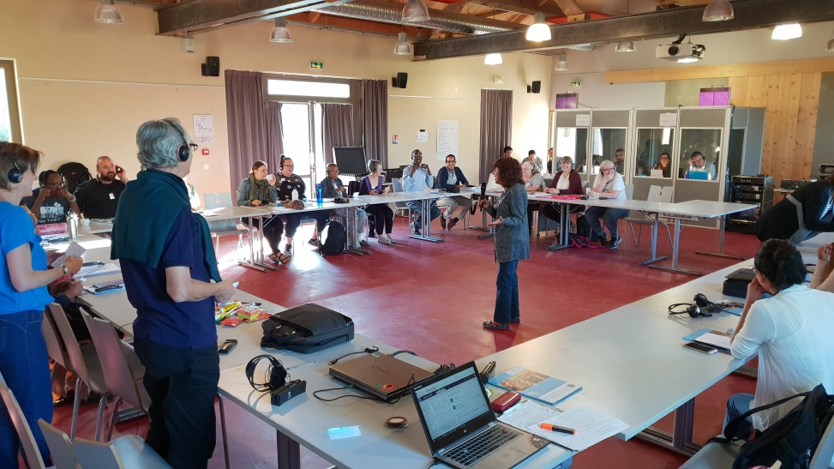
Merging of knowledge Time and money to support a steady process

Slide 5
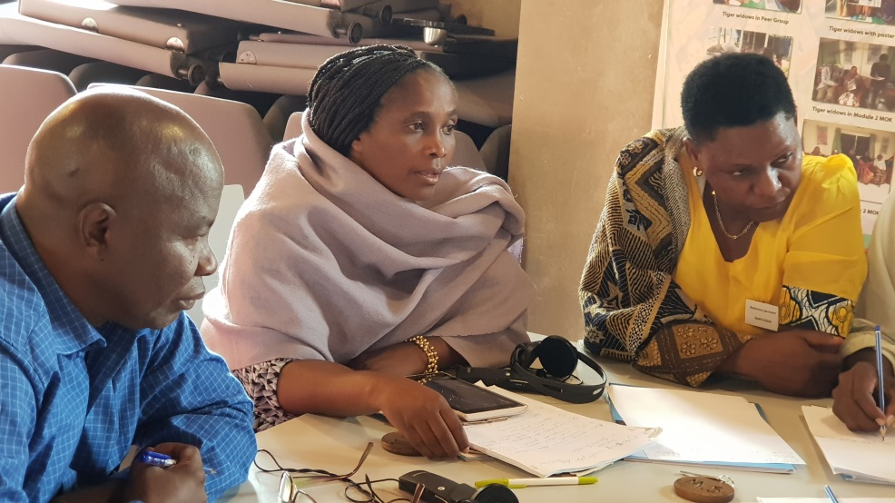
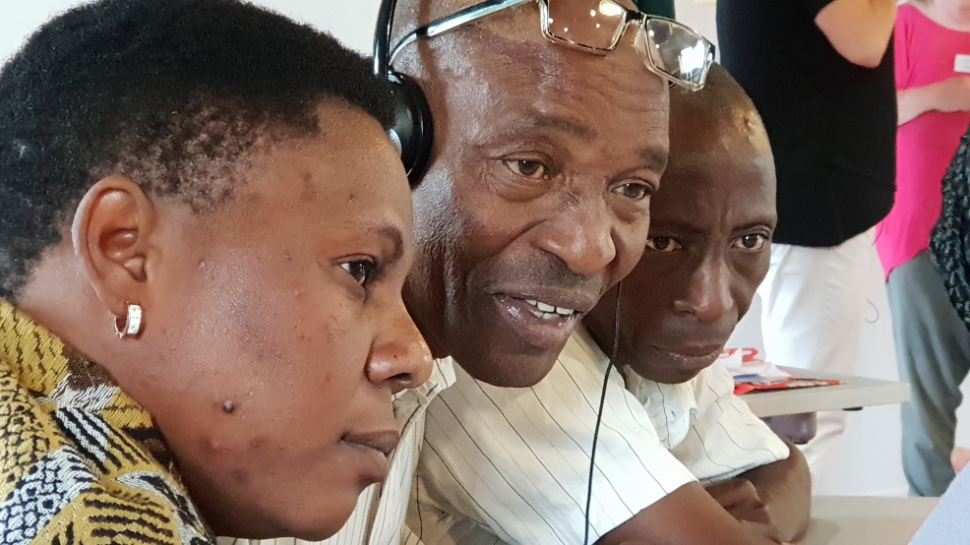
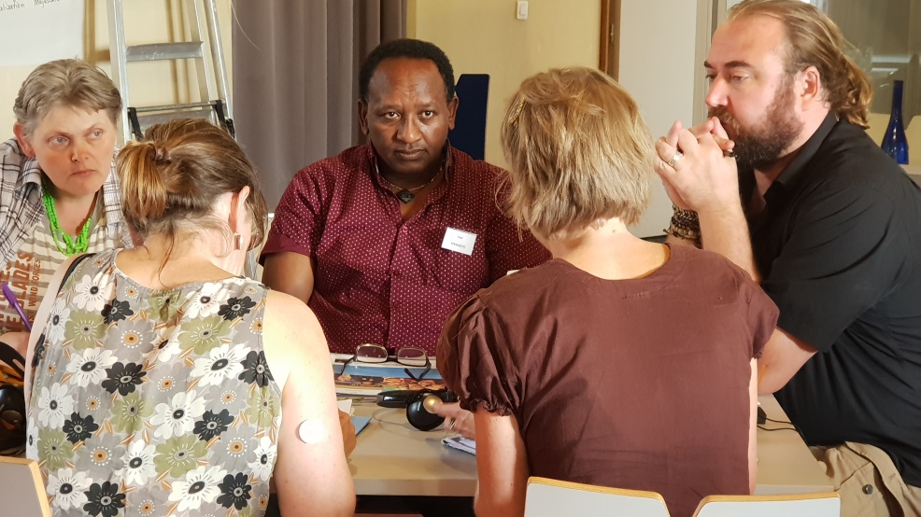
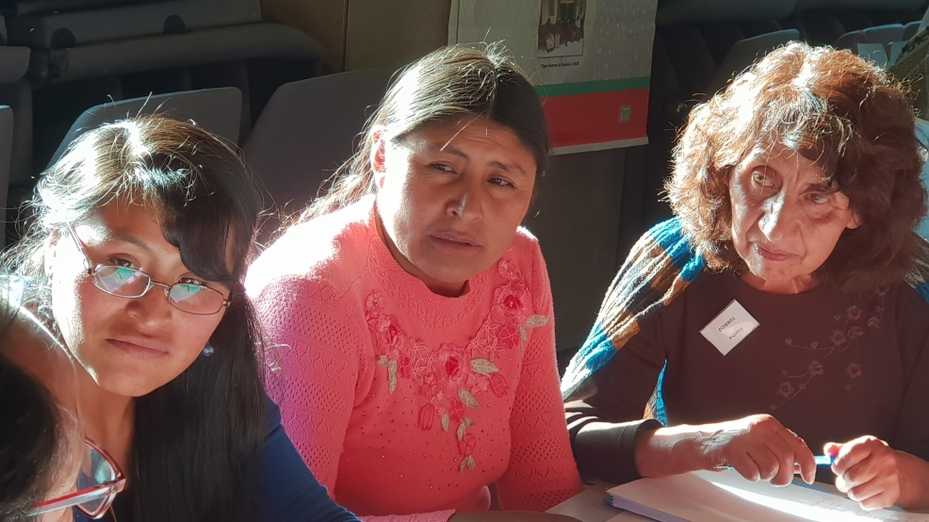
Merging of knowledge => new knowledge
via mutual recognition, trust and reflective questioning

Slide 6
Social maltreatment
Lack of decent work
Location
Identity
Disempowerment
Disempowerment
V
Institutional maltreatment
Suffering, body mind & heart
Insufficient & insecure income
Struggle
& resistance
Timing & duration
Environment & environmental policy
Unrecognised contribution
Material & social deprivation
Core experience
Relational dynamics
Privations
Modifying factors
Culture and beliefs

Slide 7
As importantly, the process achieved…
Grounding for lasting change
Transformation for all people/organisations involved
Action follows the deep attitudinal change in everyone
New ways of thinking about poverty
New ways of working…??
Partnerships between institutions evolve naturally
as grounded in deep collective analysis

Slide 8
Challenges and how to meet them
Requires much time, skill, commitment
Invest wisely to ensure value for all
Choice of stakeholders as peer groups
Adapt to the question and context
Coping with difference when ‘merging’
Record process towards consensus
Respect disagreement, retain specificity

Slide 9
Clear potentials for the Merging of Knowledge
Further work with children and with older people
Developing further indicators for SDG target 1.2
Use in policy-making…
For more insights, see our newly-released report:
Google “The hidden dimensions of poverty”

