Slide 1

Delivering on the Leave No One Behind promise & ensuring the voices of those furthest behind can be heard
Oli Henman, Global Coordinator, A4SD
oli.henman@action4sd.org

Slide 2
What is Action for Sustainable Development?
Inclusive cross-cutting civil society platform
Aims to bring citizens and civil society together to inspire and to commit to actions that empower all peoples for a more just and sustainable world, especially those who have been marginalised
Provides horizontal engagement framework for national and regional partners

Slide 3
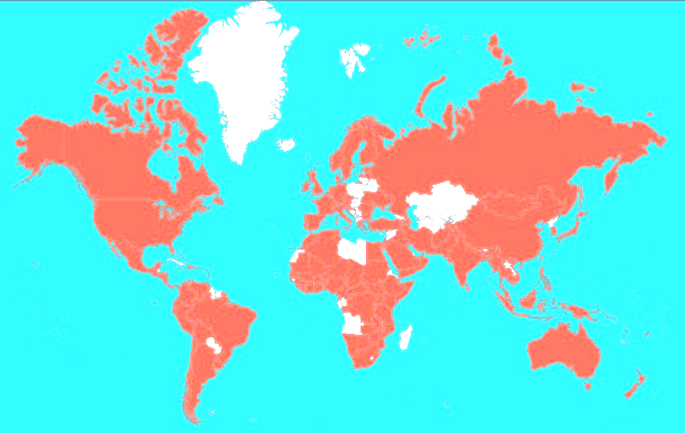
3,000+ members in over 155 countries
(80% of members in Global South)

Slide 4

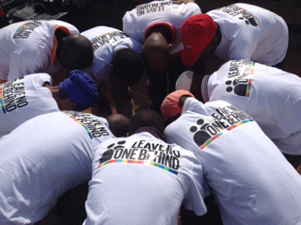
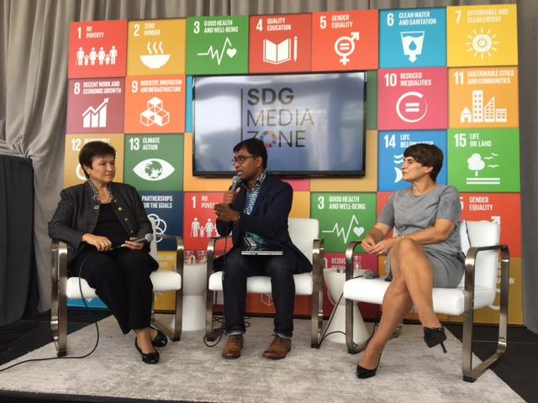
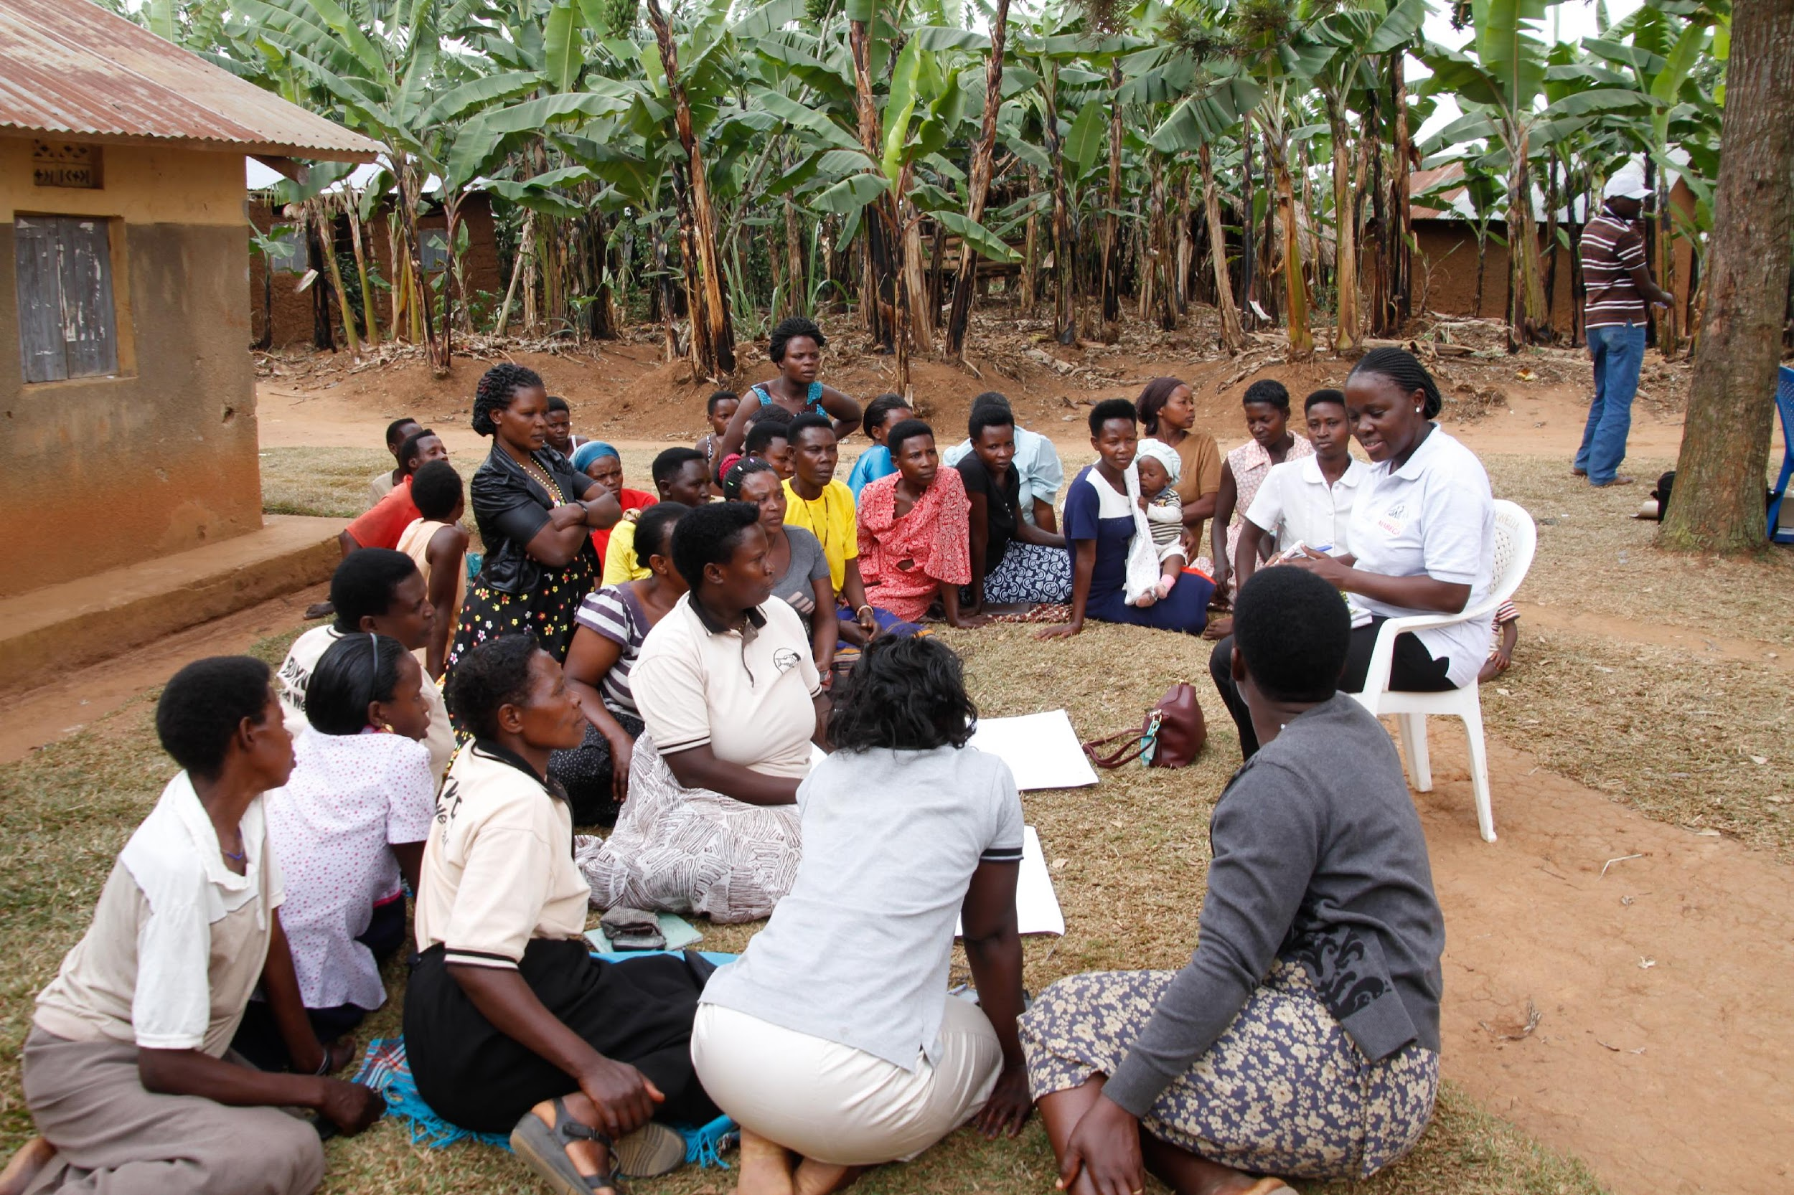



Leave No One Behind Partnership
www.LeaveNoOneBehind.global
Notes:
Alice

Slide 5
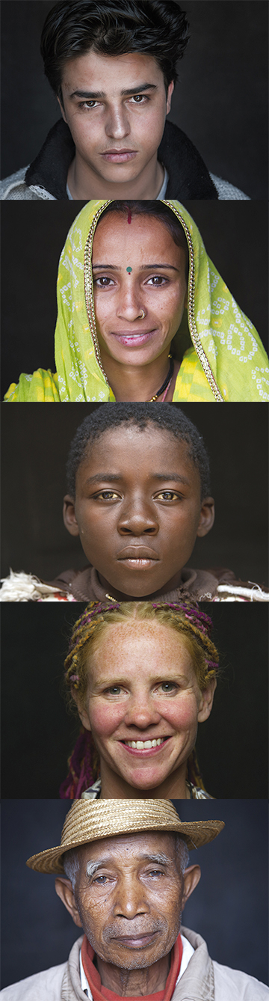
Approach
To ensure that voices of the most marginalised are heard; so that governments deliver on the promise
The Partnership aims to catalyse sustained action, commitment
and responsibility that is needed from the global community (including governments, private sector, civil society, UN, international organisations and citizens) to implement the Global Goals so that no one is left behind.
To help secure a long-term broader partnership to turn it into a reality
There are three principles at the core:
EXAMINE
EMPOWER
ENGAGE
Notes:
Examine: Providing new data on who is at risk of being left behind, why and where; putting a spotlight on the most marginalized groups and monitoring progress on reaching those furthest behind first.
Engage: reaching out to people all around the world, through the creation of compelling content and telling the stories of those who are being left behind
Empower: directly supporting people from the most marginalised backgrounds to be able to speak for themselves. Working directly with partners in over 30 countries to build local voices for action and accountability.

Slide 6
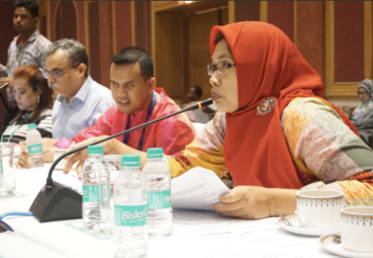
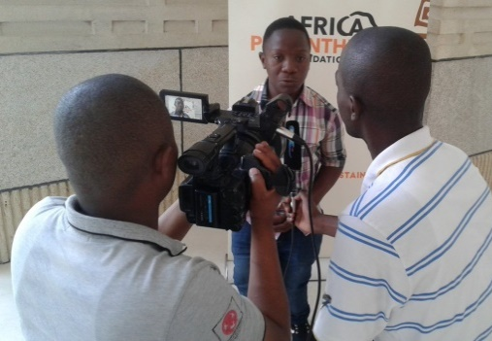
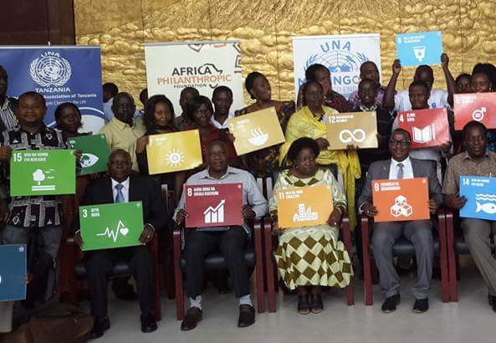
Process in 2016-2017
Leave No One Behind Partnership: What’s happened so far
30 national dialogues taking place around the world from Fiji to the Philippines to Rwanda to Peru.
Global report establishing a baseline of who the poorest 20% of people are globally.
Survey reached 5,000+ respondents from 40 different countries.
Film shown to Heads of State at opening of UN General Assembly and around the world.
High-level events hosted with Ministers at the High Level Political Forum (July 2016) and at the UN General Assembly (September 2016).
Notes:
Alice

Slide 7
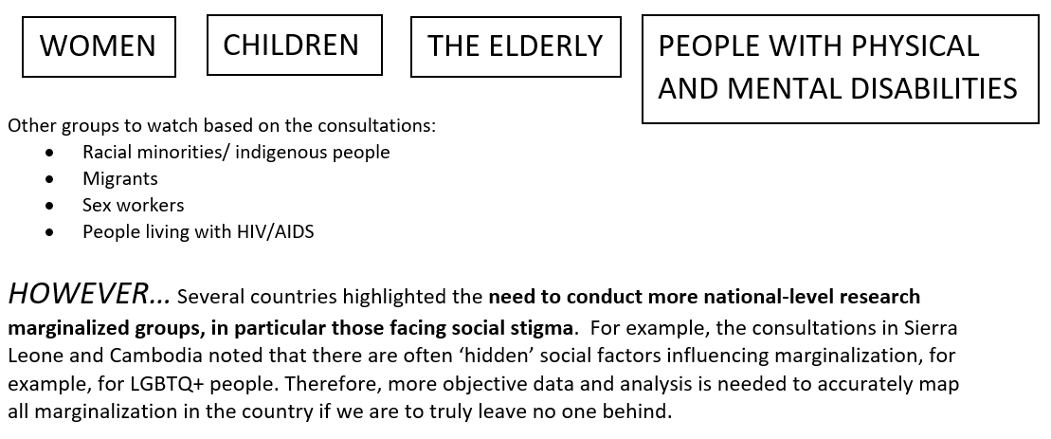
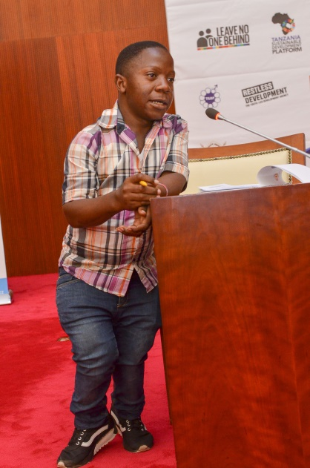
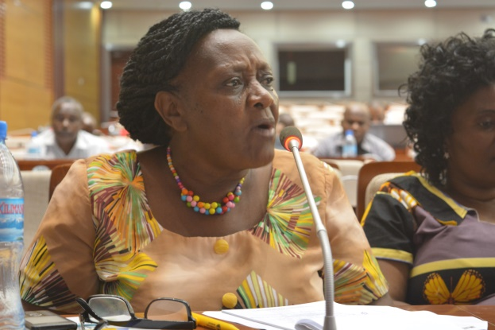
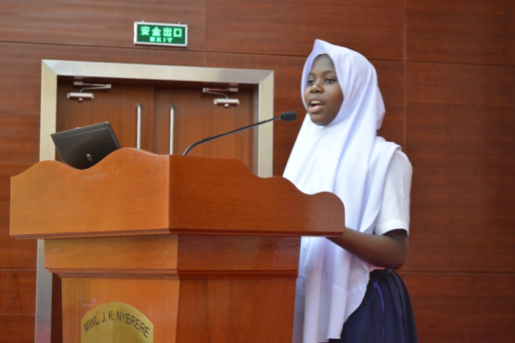
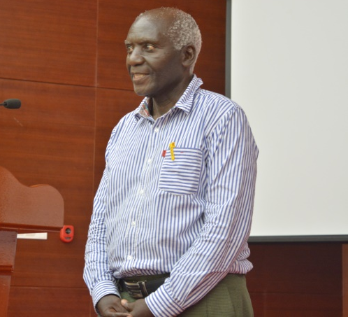
GLOBAL TREND #1: Who is most at risk of being left behind?
Notes:
Photos from Tanzania

Slide 8
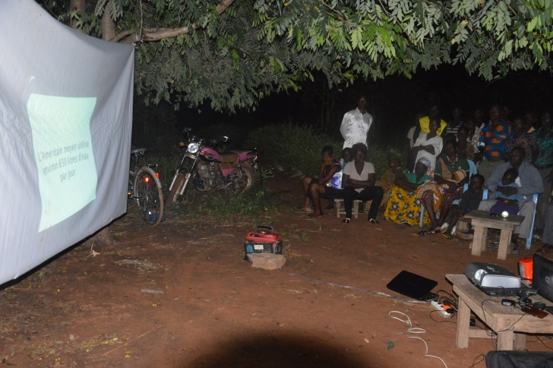
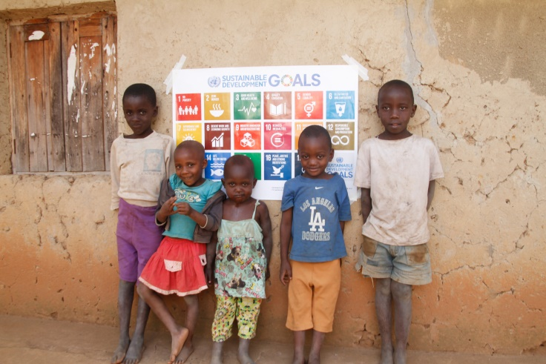
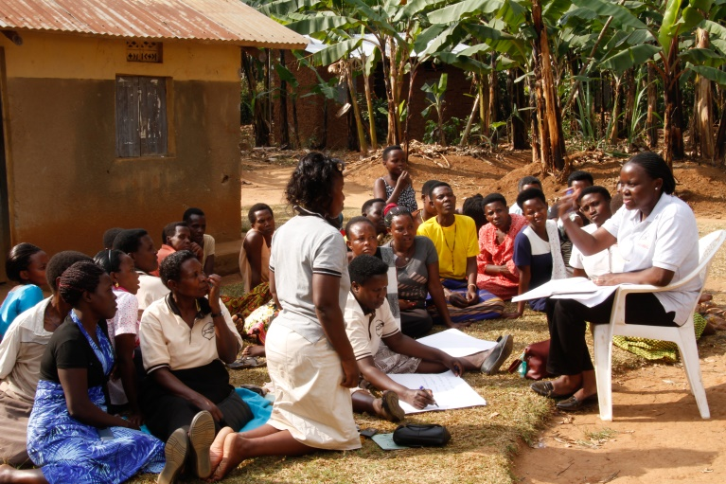
GLOBAL TREND #2: Where you are is as important as who you are
A wide range of factors lead to marginalization, including:
  Income
  Education
  Access to medical services
However, many participants also highlighted the importance of location, in an often complex picture
  Examples include a high risk of marginalization within urban centres and their immediate environs (Bolivia, Brazil and Togo), within specific provinces or areas of the country (the coastal areas of El Salvador, or the provinces North and East of Uganda), or within close proximity to conflict zones (Palestine).
Notes:
Photos from Togo and Uganda

Slide 9
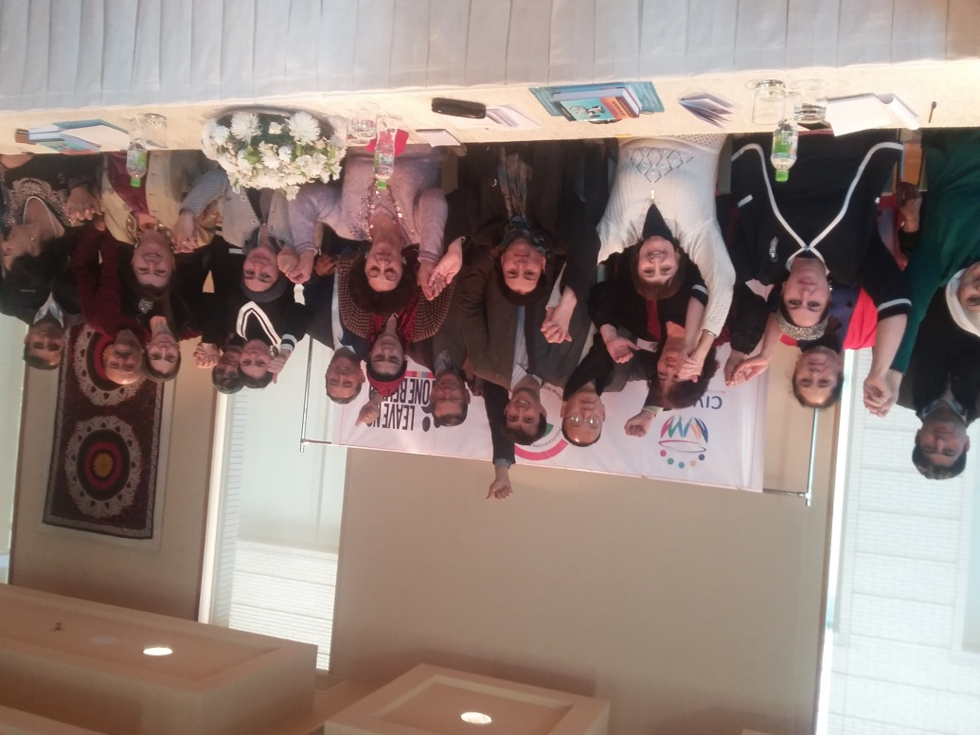
GLOBAL TREND #3: Focus on the community
While national-level government engagement is important to delivering on Agenda 2030, many participants noted that to truly ‘leave no one behind’, the strategic process must engage and empower the local communities in which marginalized groups are most at risk. For example:
  In El Salvador, participants emphasized that fostering greater opportunities for self-regulation and community engagement is essential in the development of communities in the country
  In Tajikistan, the lack of access to decision making, particularly at the local/community level was highlighted as a key contributor to marginalization.
Notes:
Picture from Tajikistan

Slide 10
GLOBAL TREND #3: Focus on the community
In India, consultation participants stated that engaging communities at the local level is essential to effectively create greater awareness and engagement of the SDG agenda amongst marginalized groups in India. Building the capacity of grassroots organizations and conducting grassroots consultations will also be key to engaging marginalized groups. Indeed, marginalized groups are more influential at the local levels than nationally, and 73% of respondents could identify SDG-related activities in their local districts/states

Slide 11
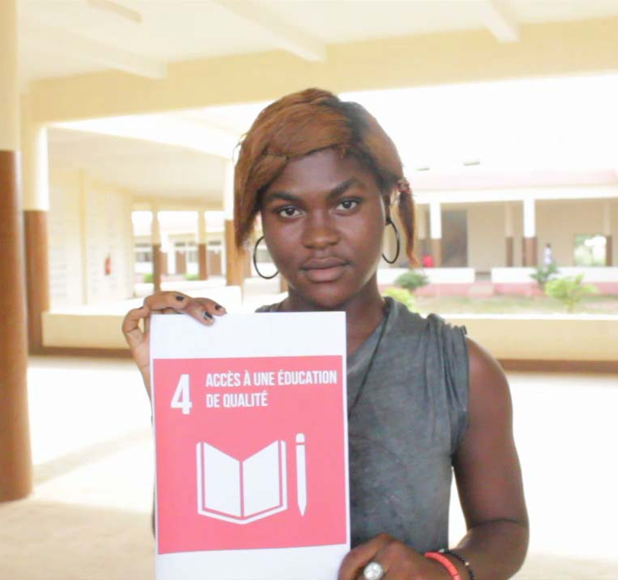
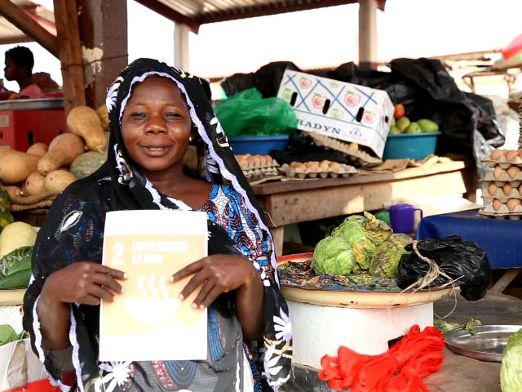
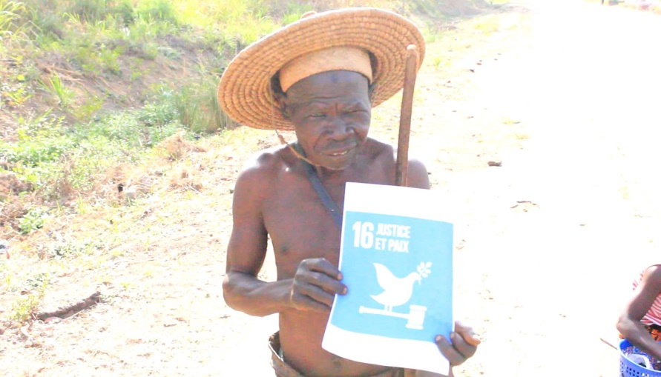
GLOBAL TREND #4: What are the SDGs again?
In spite of global campaigns around Agenda 2030, many LNB National Dialogues pointed to a very low level of understanding at the national and local levels about what the SDGs are; how civil society and the government are engaging in the process to implement the SDGs in the country; and how individuals or organizations can get involved.
There was broad consensus on the need for a much more robust and community-focussed engagement strategy to build awareness and ownership of the SDGs amongst those most at risk of marginalization, as well as those people and organizations working on the ground to support them.
Notes:
Pictures from Togo

Slide 12
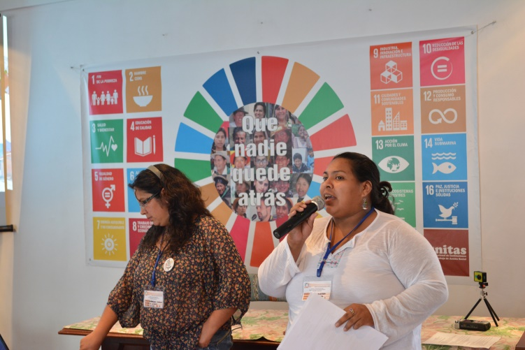
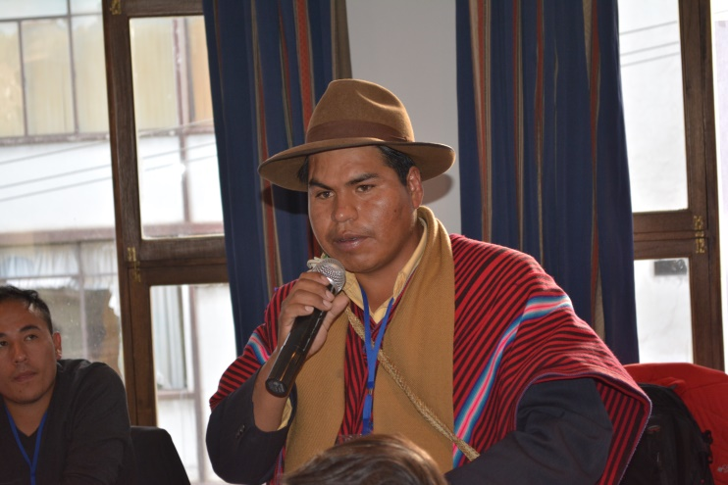
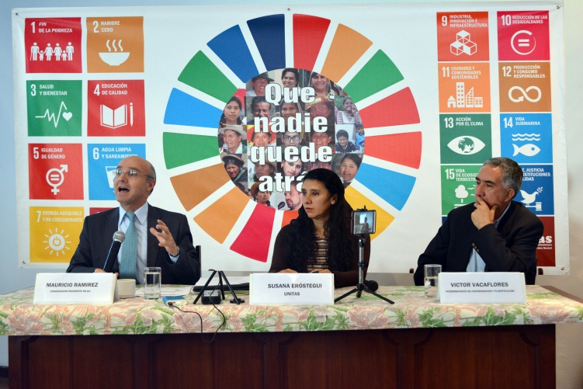
GLOBAL TREND #5 The role of CSOs in leaving no-one behind
While a multi-stakeholder approach is needed to achieve the SDGs, many participants contributed insights and guidance on the role civil society should play to ensure no-one is left behind. Some highlights include:
Bolivia: CSOs must help ensure citizens are actively involved in the planning, execution and monitoring of SDG implementation
El Salvador: CSOs must better integrate marginalized groups into their work around the SDG implementation process
National Dialogue in Bolivia

Slide 13
How to ensure accountability through a People’s Scorecard
2019 is the fourth year, end of first cycle- some countries are already reporting for second (or even third) time
Civil society often produces a ‘shadow’ report responding to the government’s own analysis
It’s now time to go further and develop our own independent analysis, eg. Sri Lanka, Brazil, Kenya
Be aware- this will require a strong core team!

Slide 14
A) Overview of current country implementation
Assessment of mainstreaming and integration of the 2030 Agenda and the 17 SDGs across national policies and implementation, focus on the three dimensions of sustainable development: social, environmental and economic
How far the ‘whole of government’ approach is carried out for SDG implementation
How the key cross-cutting principles as “Leaving No One Behind” and “Respecting Planetary boundaries” are included in all policies, and any gaps identified.
Analysis of financial mechanisms and resource; also what other kinds of partnerships have been set up, what is the role of different actors (including private sector) and which donors are involved?

Slide 15
B) Convene national multi-stakeholder dialogues
Convene dialogues across civil society to identify shared priorities
At least one national meeting and where possible at least 3 sub-national meetings bringing together a cross-section of organisations working on the key topics of the SDGs, including: poverty, food, biodiversity, water and sanitation, equality, climate, transport, urban planning, governance etc

Slide 16
B) Convene national multi-stakeholder dialogues- LNOB
Ensure the national coalition crosses different sectors and includes different constituency groups, as well as contains a geographic (urban and rural), age, disability and gender balance
Ensure that as many as the following groups are included in your dialogue: women and girls, persons with disability, trade unions, young people, older people, Indigenous peoples, small scale farmers, environmental activists, LGBTQI, Religious and ethnic minority groups

Slide 17
C) Review of the 17 Goals & Summary Report
Conduct evidence-based assessments, using disaggregated data and citizen generated evidence on the progress and challenges of the 17 SDGs
Consider availability of data as well as potential gaps in evidence, including identifying what official data exists plus cross-reference with local citizen generated data sources where possible
Look at key Goals and principles and potential clusters around key issues for your country context.

Slide 18
C) Review of the 17 Goals & Summary Report- analysis framework
1 No Policy/Plan | 2. Initial planning phase | 3. Plans or actions started | 4. Delivery underway | 5. Succesful implementation
a) No/weak Policy/legal framework available | Policy/legal framework in planning phase | Some Policy/legal framework available | Policy/legal framework agreed | Strong Policy/legal framework in use
b) No/weak plans and strategies exist | Plans & strategies in planning stage | Some Plans and strategies exist | Plans & strategies agreed | Strong Plans and strategies exist
c) No/weak Agencies with clear mandate available | Agencies planning their engagement | Some Agencies with clear mandate available | Agencies beginning to develop their implementation | Strong Agencies available with clear mandate
d) No/weak implementation of policies, plans and strategies on regular basis | Implementation of policies, plans and strategies in planning phase | Some implementation of policies, plans and strategies on irregular basis | Implementation of policies, plans and strategies has started across all areas | Strong implementation of policies, plans and strategies on regular basis
e) No/weak Awareness and capacity building available | Planning on awareness and capacity building needs | Some Awareness and capacity building available | Awareness & capacity building activities are beginning | Strong Awareness and capacity building available
f) No baseline indicators set | Planning and consultation on baseline indicators | Some baseline indicators set | Baseline indicators being finalised | Strong baseline indicators set
g) No/weak monitoring, evaluation & reporting is available | Monitoring, evaluation & reporting plans are agreed | Some monitoring, evaluation & reporting is available | Monitoring, evaluation & reporting underway on all Indicators | Regular monitoring, evaluation & reporting is available
h) No access to information is available | Initial agreement on access to information | Some access to information is available | Access to information is underway on all Indicators | Strong access to information is available
i) No/weak transparency and accountability mechanism available | Initial planning for transparency & accountability mechanism | Some transparency and accountability mechanism available | Transparency & accountability mechanism being implemented across all Indicators | Strong transparency and Accountability mechanism available

Slide 19
C) Review of the 17 Goals & Summary Report- Goal example
Goal 1 End Poverty in all its forms everywhere
Has the government created a specific plan and begun implementation to tackle this goal nationally?
Are other levels of government (local, provincial) involved in implementing this goal?
What is the evidence base being used to measure implementation, is it disaggregated and is it transparent and freely available?
Has civil society been involved in setting out the implementation strategy; planning approach; and in defining the evidence base?
Any additional comments for this goal or plan?
How do you assess the effects of this Goal’s implementation on other Goals and towards achieving sustainable development as a whole? What are the other key Goals you see complementing achieving this Goal?
Overall rating 1-5:

Slide 20
C) Review of the 17 Goals & Summary Report
Finally: develop a Summary that provides a qualitative analysis of the interlinkages between goals
This should include potential trade-offs that are being considered, eg. increased economic growth at the same time as increased inequality and/or environmental degradation.

Slide 21
D) Hold a final consultation meeting to validate your findings
Based on the Goal by Goal analysis, draft of full report should be shared
Share the draft with your national partners in the first instance to enable a final chance for feedback and validation by civil society partners
Once you have a consensus the report can be shared with government and used for wider advocacy

Slide 22
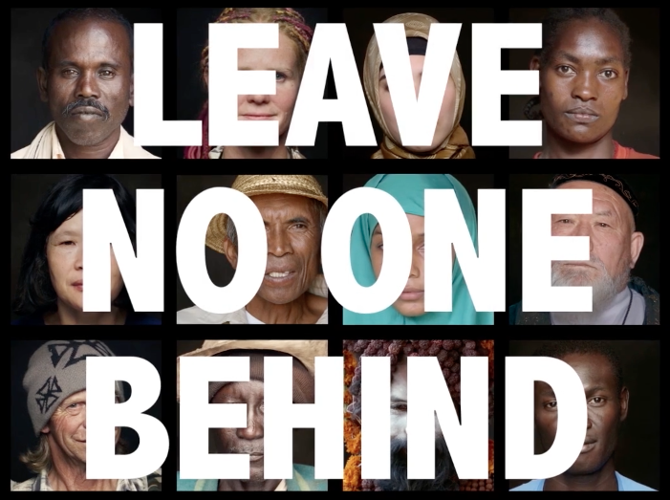

Notes:
FIlm link - Alice

Slide 23
For more information please check our website:
https://action4sd.org/tools-resources/
Contact: Oli Henman, Global Coordinator, A4SD
oli.henman@action4sd.org

