Slide 1
Participatory and Inclusive Tools to build capacities in Leaving No One Behind
#HLPF2019 #MakingVoicesHeardandCount
SDG’s Learning, Training and Practice Workshops during HLPF 2019

Slide 2
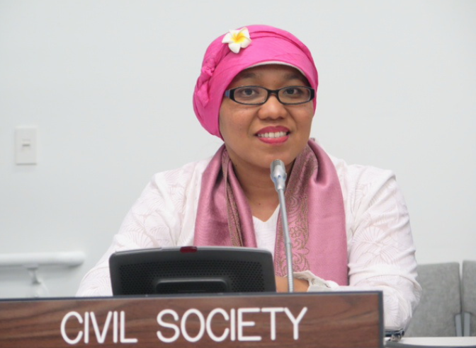
Moderator
Risnawati Utami
#HLPF2019 #MakingVoicesHeardandCount
Gender and disability rights activist, Member of the Committee on the Rights of Persons with Disabilities.

Slide 3
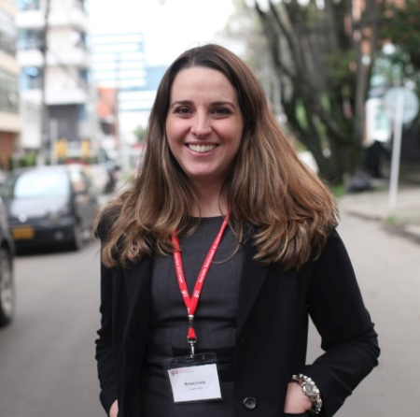
Opening Speaker
Naira Costa
#HLPF2019 #MakingVoicesHeardandCount
Senior Sustainable Development Officer, Division for Sustainable Goals, UN DESA

Slide 4
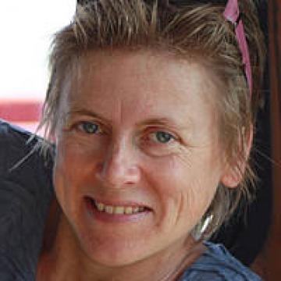
Rachel Bray
#HLPF2019 #MakingVoicesHeardandCount
Research Associate, Dept. of Social Policy and Intervention, Oxford University

Slide 5
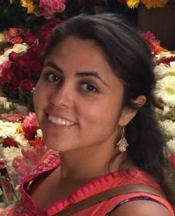
Erika Lopez Franco
#HLPF2019 #MakingVoicesHeardandCount
Participation, Inclusion and Social Change Research Cluster, Institute of Development Studies

Slide 6
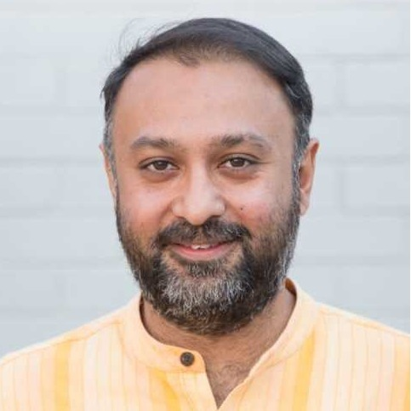
Mandeep Tiwana
#HLPF2019 #MakingVoicesHeardandCount
Head of Policy and Research at the global civil society alliance, CIVICUS

Slide 7
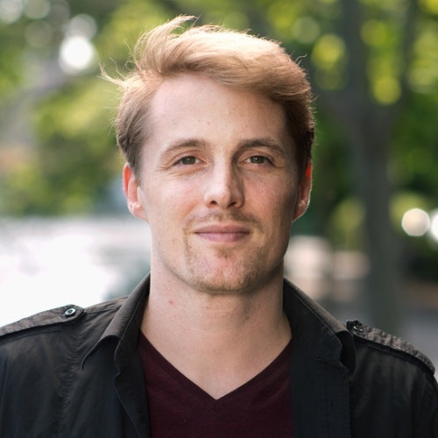
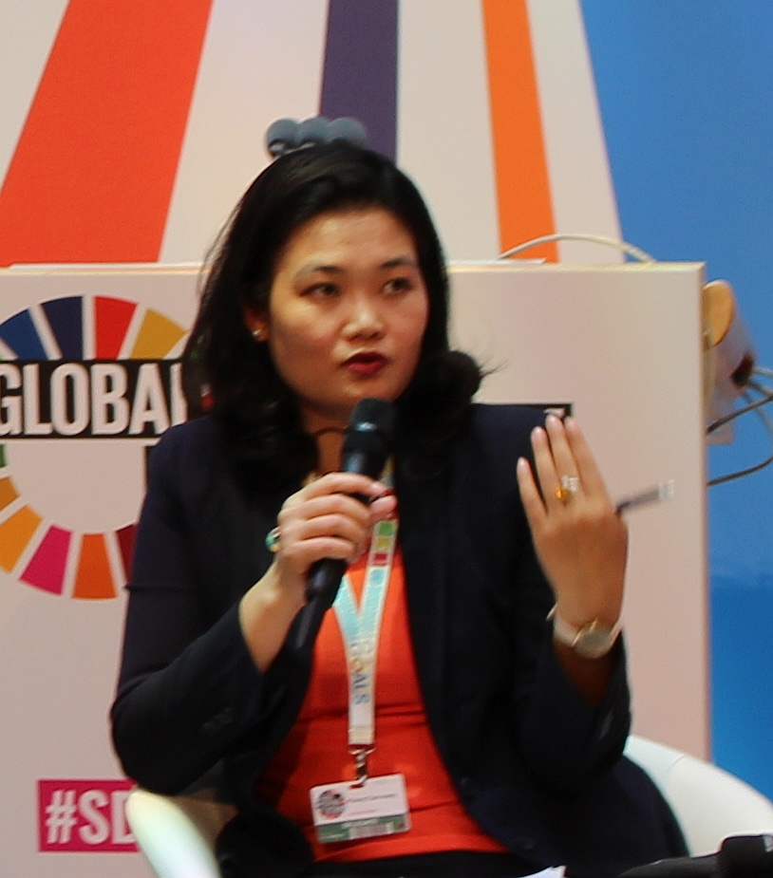
Peter Koblowsky and Hoang Phuong Thao
#HLPF2019 #MakingVoicesHeardandCount
International Civil Society Centre and ActionAid Vietnam

Slide 8
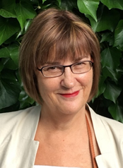
Moderator
Sylvia Beales
#HLPF2019 #MakingVoicesHeardandCount
Stakeholder Group on Aging

Slide 9
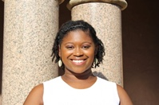
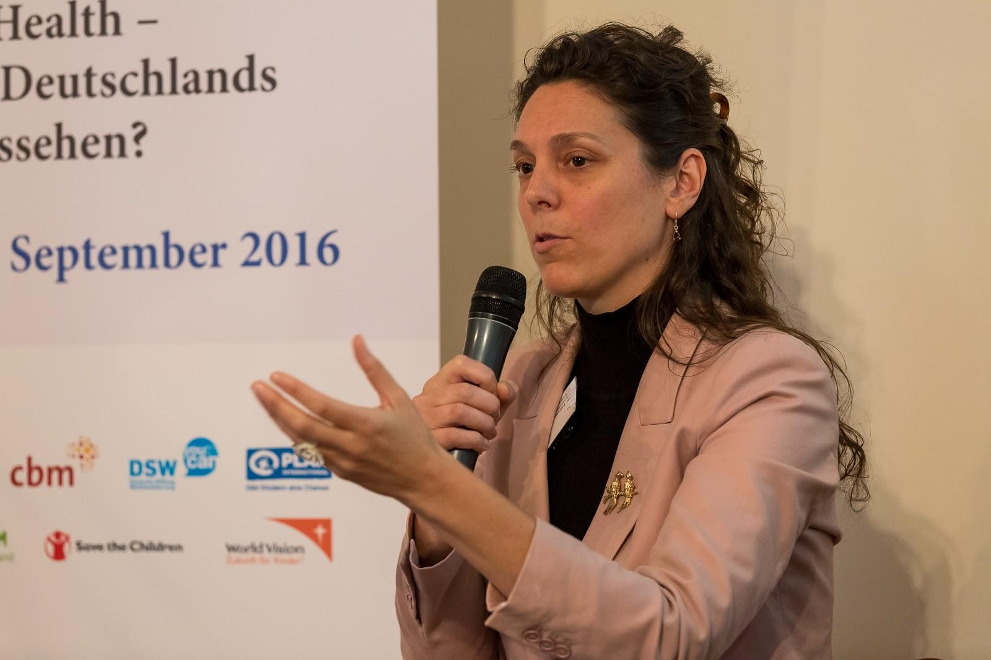
Dr. Elizabeth Lockwood and Maegan Shanks
#HLPF2019 #MakingVoicesHeardandCount
CBM and Gallaudet University; Introduction to Deaf culture

Slide 10
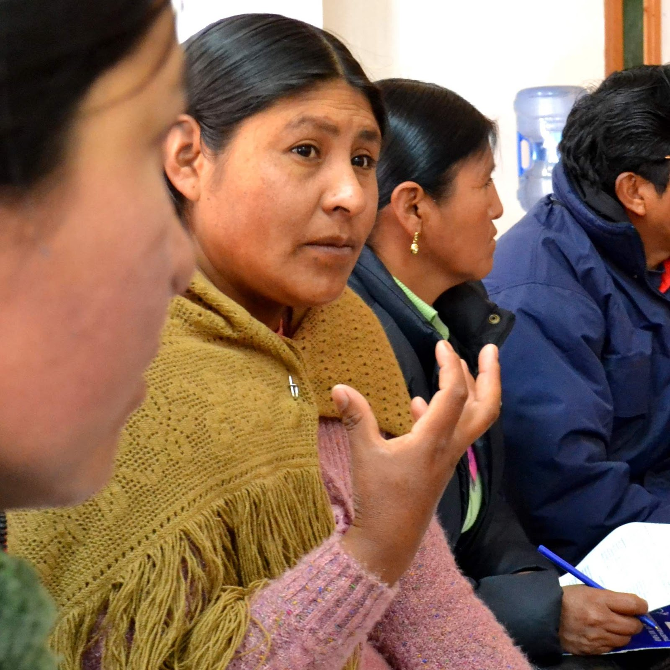
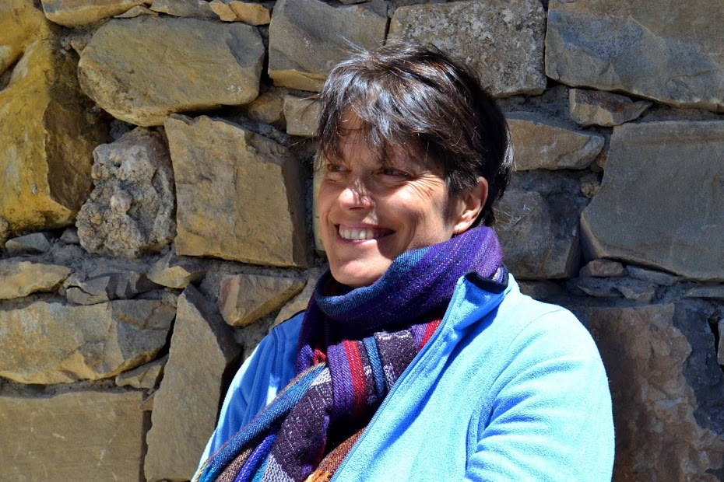
Roxana Petrona Quispe Yujra
and Sophie Boyer
#HLPF2019 #MakingVoicesHeardandCount
ATD Fourth World Bolivia

Slide 11
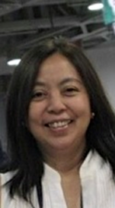
Beckie Malay
#HLPF2019 #MakingVoicesHeardandCount
Global Call to Action against Poverty- GCAP

Slide 12
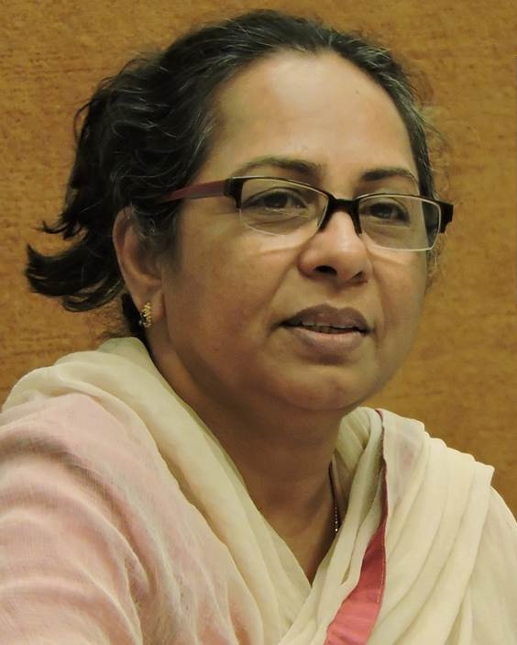
Annie Namala
#HLPF2019 #MakingVoicesHeardandCount
Wada Na todo Abhiyaan

Slide 13
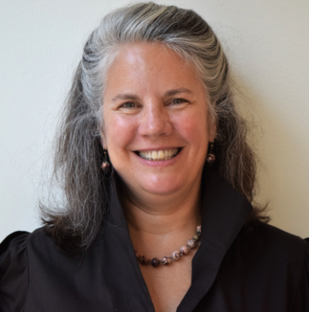
Moderator
Lindsay Coates
#HLPF2019 #MakingVoicesHeardandCount
Managing Director, BRAC Ultra-Poor Graduation Initiative (UPGI)

Slide 14
Questions
How this resonates with your context
What are the challenges
Any reflections

Slide 15
Group sharing
GROUP 1
Love and care are elements that we have to also consider
No national awareness
How do we reach the most marginalized? Stigma exists
GROUP 2
Multiple groups that can be marginalized
We must try to make genuine efforts to reach the people
Sharing data is very important: taking time to sit together, share knowledge
Connecting with the poorest is a challenge
How to connect at the local level and not only at the global

Slide 16
Group sharing
GROUP 3
How do we reach the most marginalized? – Reaching PWDs and others. We are working in silos, despite that we work in similar places
It is not only about how to the most marginalized but also the authorities and powerholders
GROUP 4
Management of knowledge
Language and language development
Looking at the different roots of the reasons for this exclusion
GROUP 5
Talked about conflicting values within organisations, how do you reconcile this differences of many sorts when pushing for inclusion

Slide 17
Group sharing
Celebration of success
Heard from very inspiring individuals and their experiences

