Slide 1

Participatory accountability that leaves no one behind
Erika Lopez Franco
July 2019

Slide 2
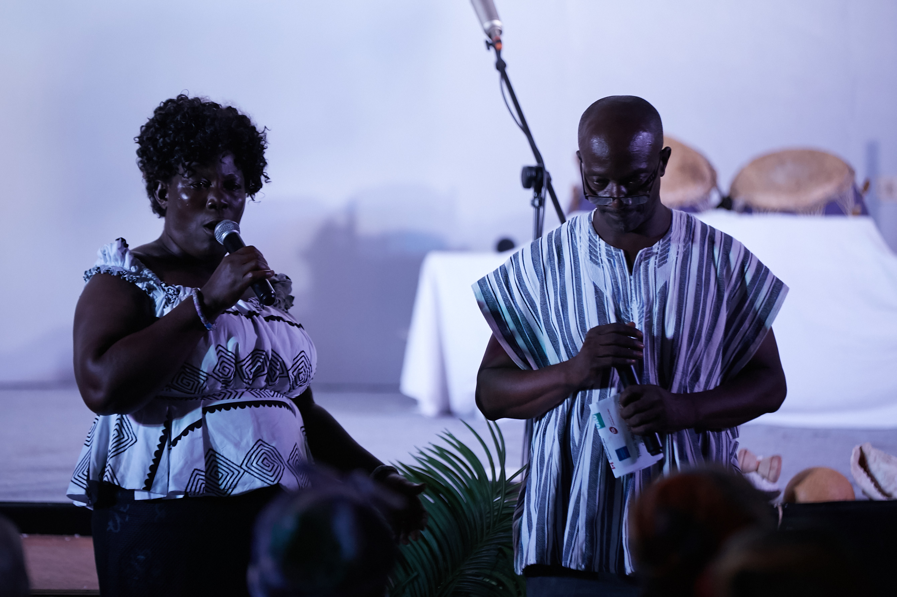
and the Yihi Katseme (i.e.brave women of Ada, Ghana)
Mary

Slide 3
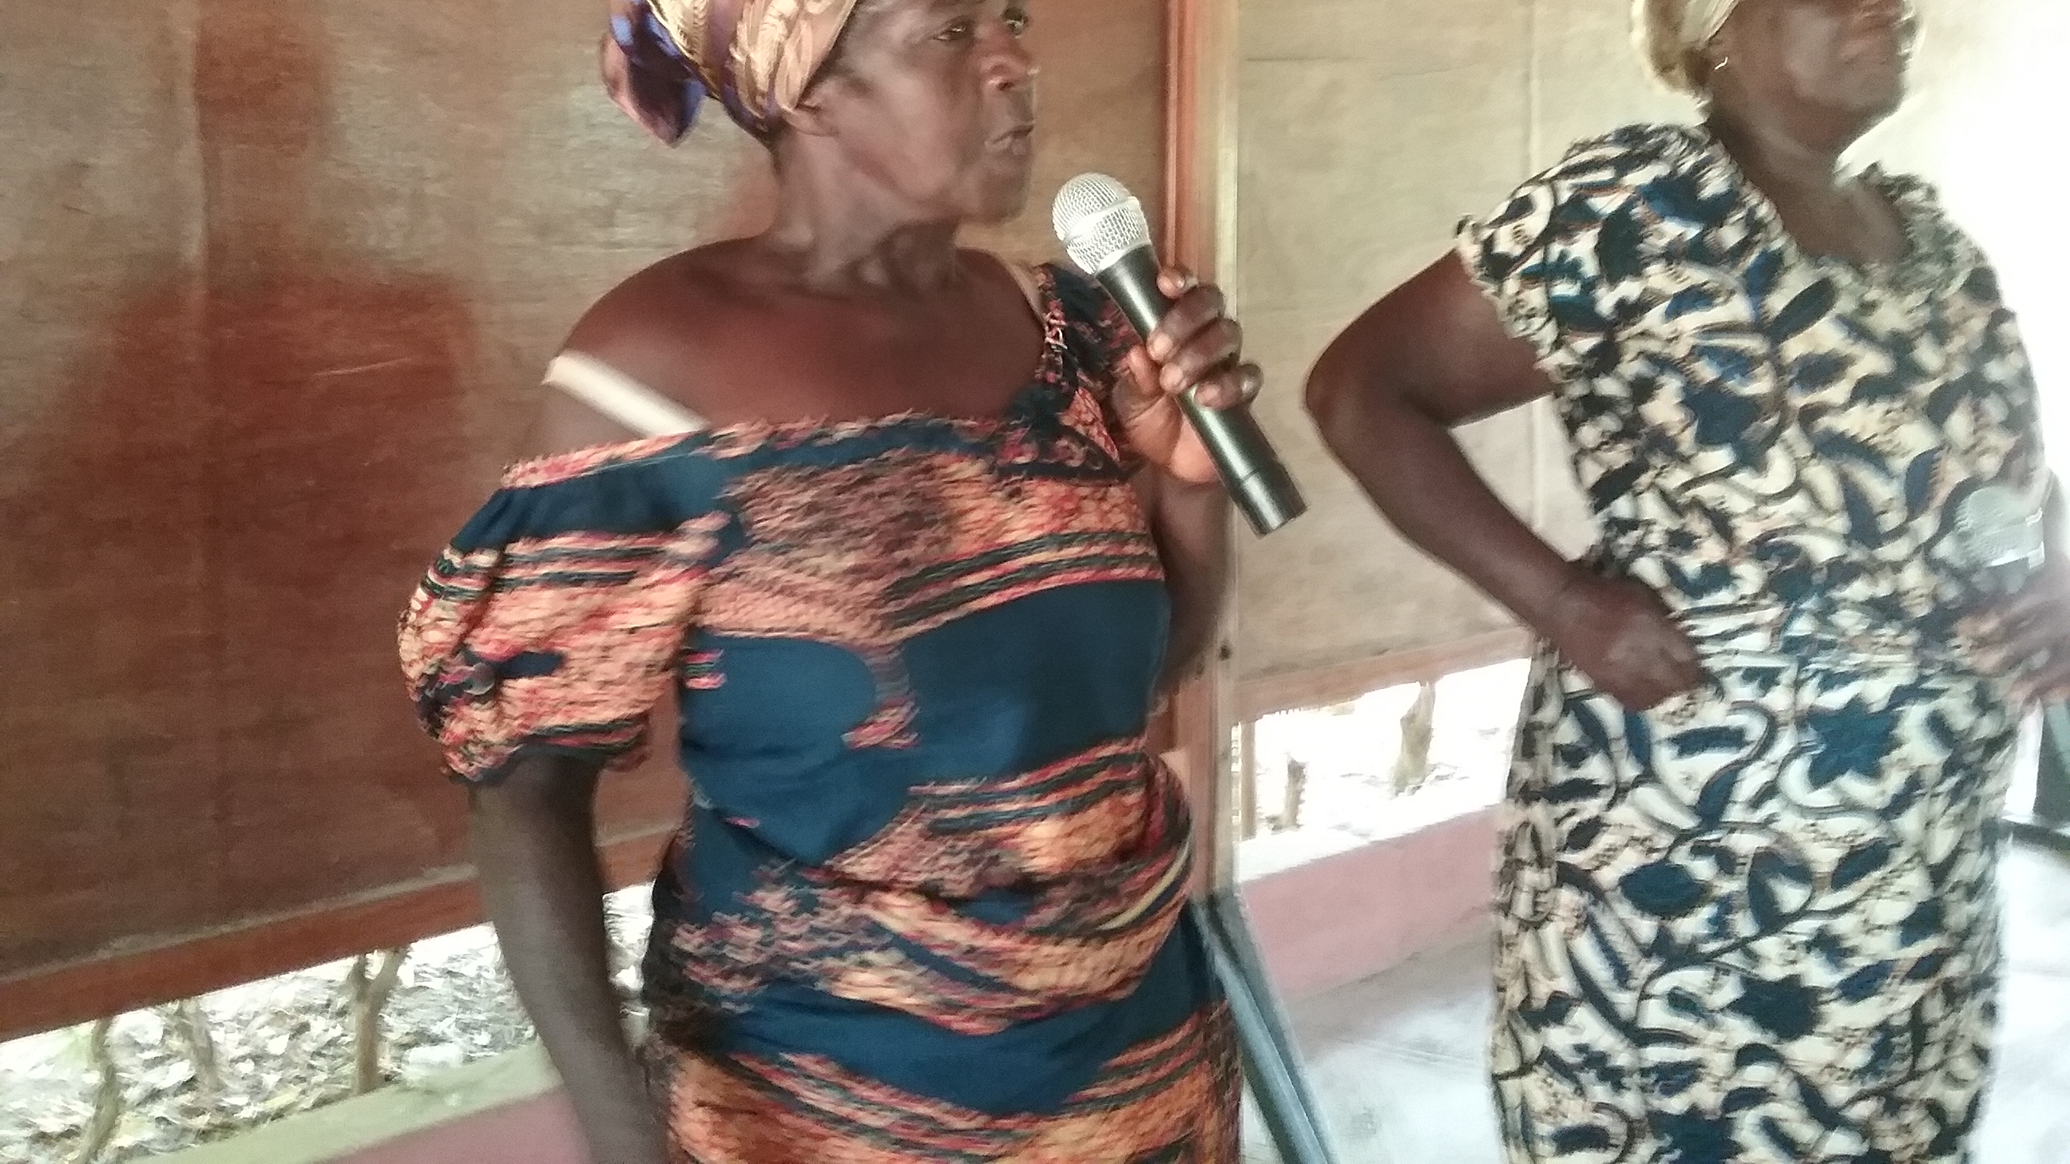
Confidence-building
“I maasi” – I am sure in myself
“Wamaasi” – We stand firm
Notes:
Mary first had to generate this confidence

Slide 4
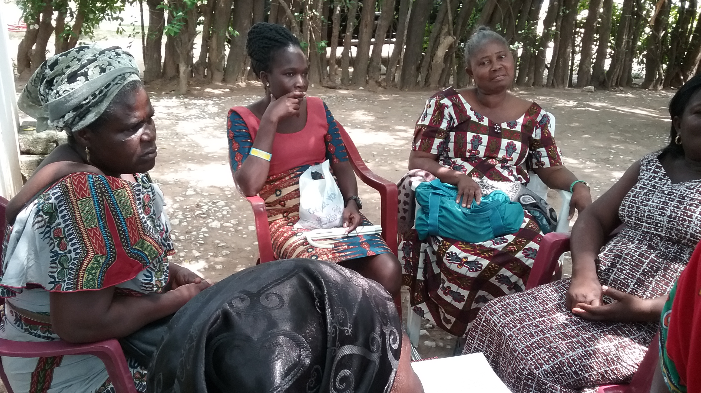
Deepening understanding of context through local knowledge
What someone knows, someone else doesn’t know…So, we all know!

Slide 5
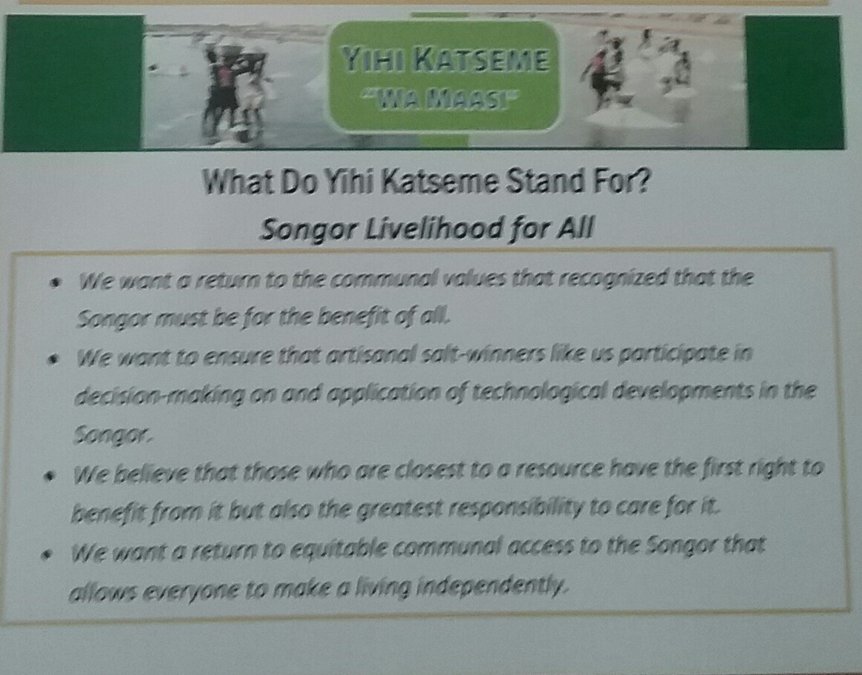
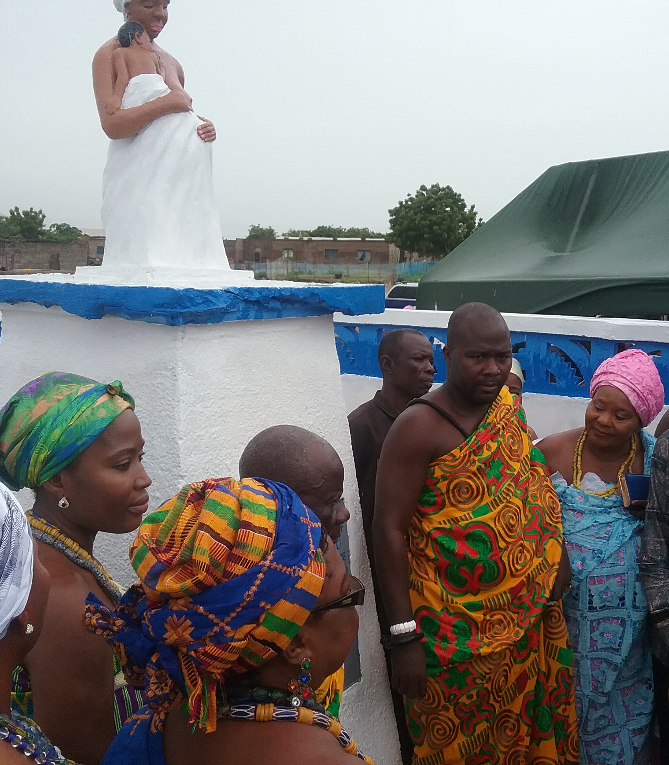
Direct engagement between citizens and authorities
Dance, song, drama + Advocacy plan

Slide 6
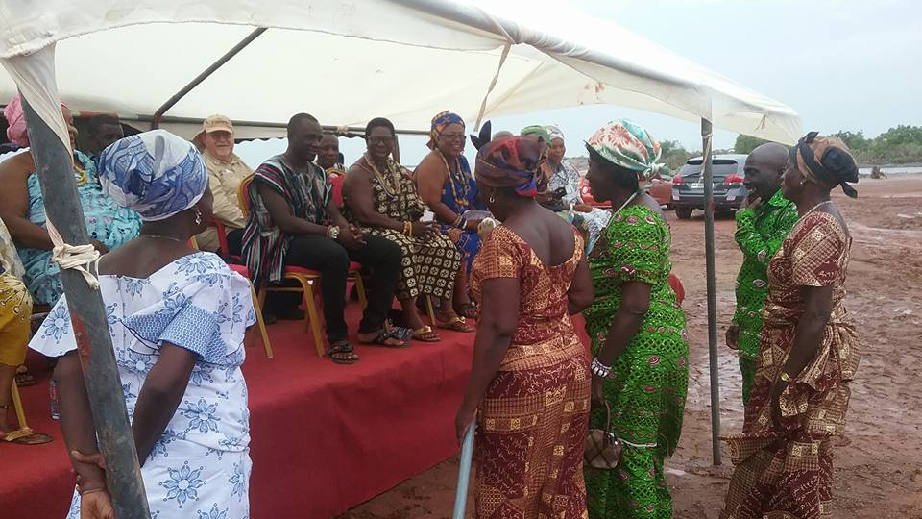
Multiple alliances and identifying champions
Leaves, sticks and stones to identify allies and powerholders

Slide 7
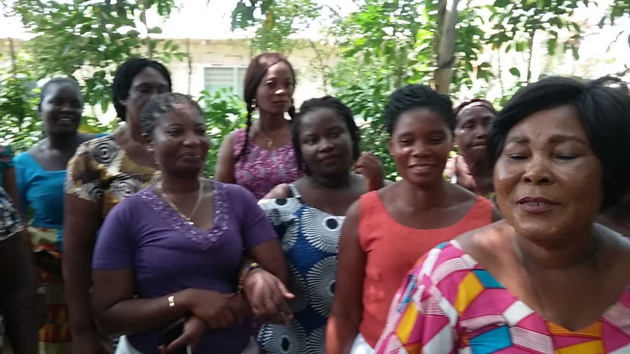
Long-term engagement and trust
Duty of care, assessing risk, meaningful partnership

Slide 8
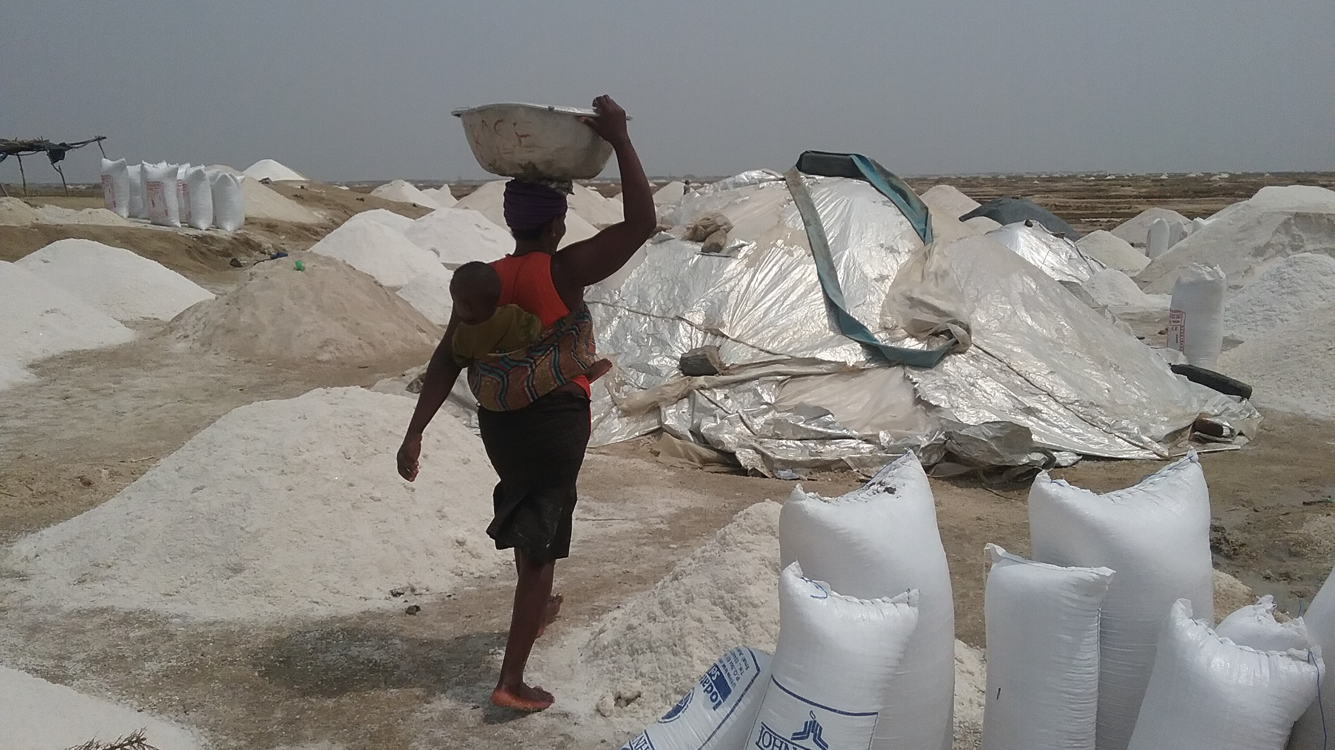
Confidence-building
Deepening understanding of context w/local knowledge
Exchanges between citizens and authorities and use of legal mechanisms
Developing alliances with multiple actors
Long term engagement and trust
Elements of participatory accountability that leaves no one behind
Contact: E.lopezfranco2@ids.ac.uk
Twitter: @EriLop
Notes:
Not a recipe; not linear, evolving of

