Slide 1
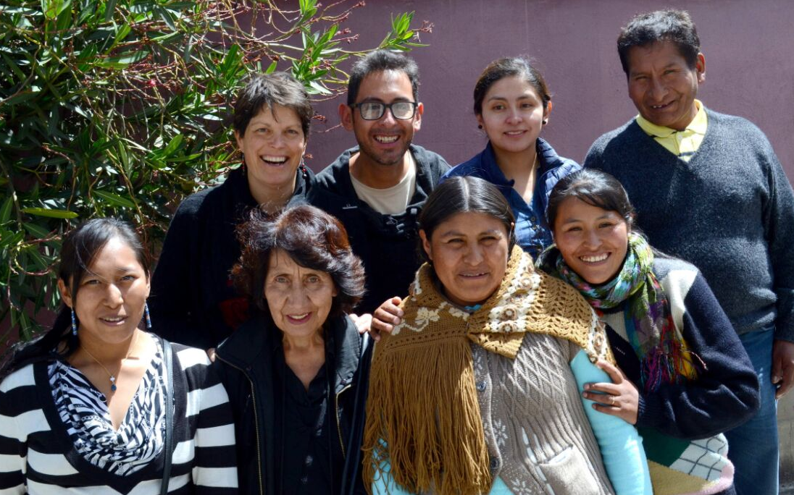
THE HIDDEN DIMENSIONS OF POVERTY
A PARTICIPATORY RESEARCH FROM BOLIVIA

Slide 2
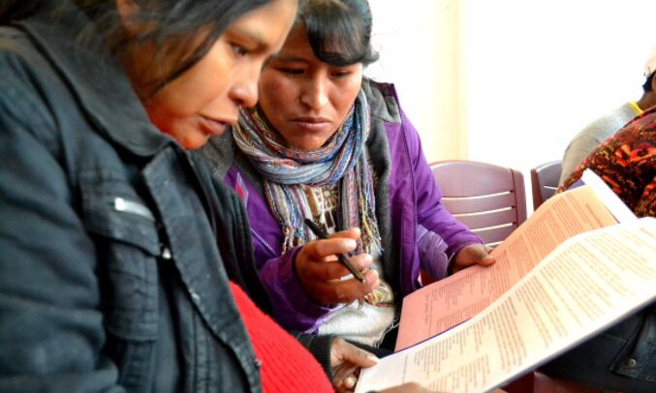
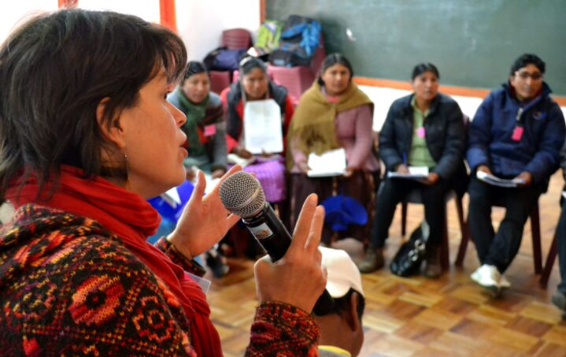
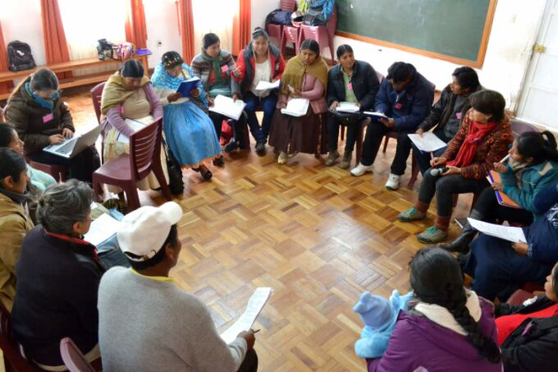
THE CONDITIONS FOR PARTICIPATION
1.Prepare and Train
2.Work in peer groups
3.Role of facilitators
4.Time
5.Remuneration

Slide 3
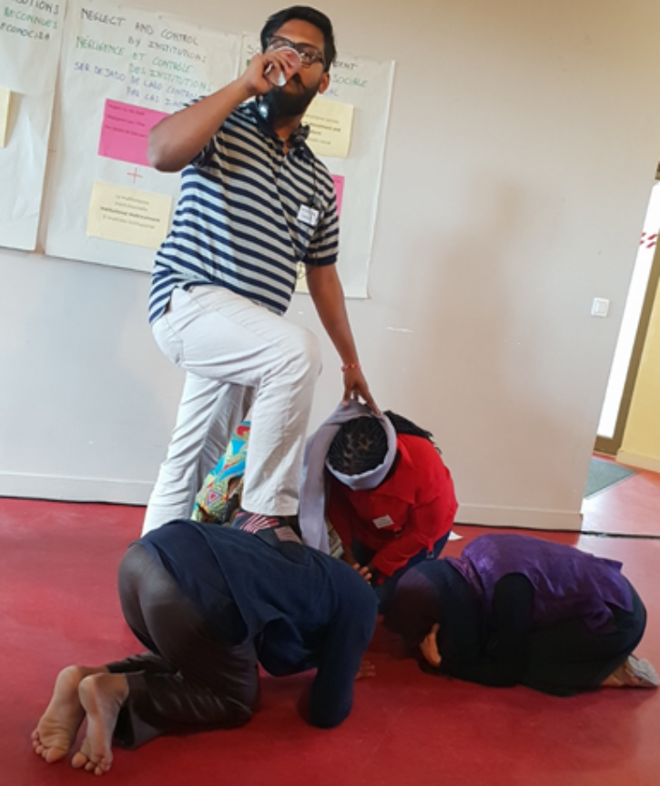
DISEMPOWERMENT
"Poverty is not having freedom"
Person with direct experience of poverty, Bolivia

Slide 4
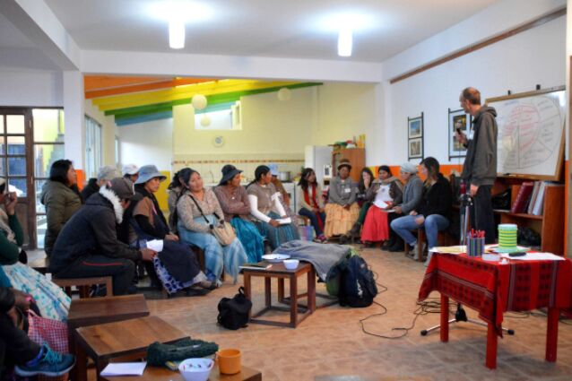
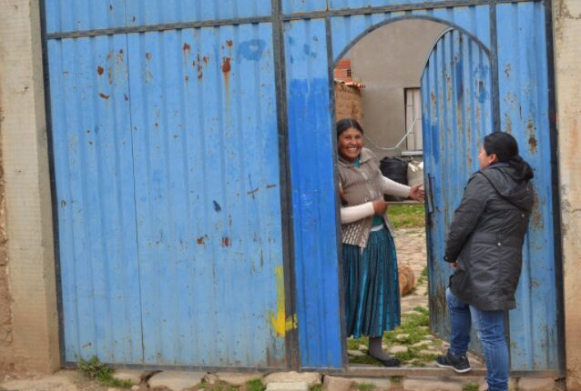
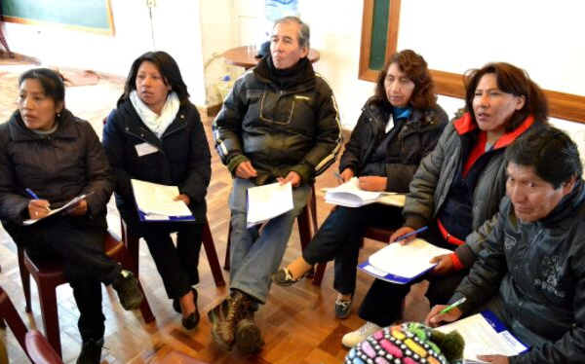
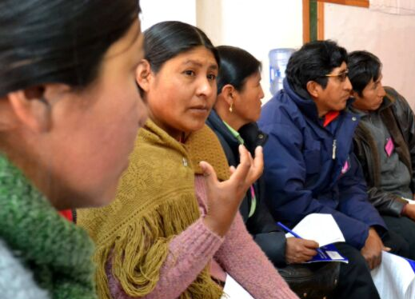
INDIVIDUAL TRANSFORMATIONS
1.Get rid of the fear
2.Grasp the meaning of what I read
3. Organizing myself better
4.Transformation within my family
5.Transformation within the team

Slide 5
CONCLUSION
- We need the three sources of knowledge to generate a complete picture.
-This requires investment to create the conditions where all can engage as equals.
- For example, developing training wokshops involving people with direct experience of poverty, academics and practitioners.

