Slide 1









2030 Agenda for Sustainable Development:
Messages from the regions
DATA
15 July 2020
ASSESSMENT
PROGRESS

Slide 2

Messages from the regions
The five Regional Commissions are taking a data-driven approach to understand “are we on track to achieve the ambitions of the 2030 Agenda for Sustainable Development”
Today’s results are part of our ongoing work, across all five regions, to provide a traffic light status of progress towards the 2030 Agenda. Data is pre-COVID and comes from DESA’s global SDG database
The results show progress is insufficient to meet the ambitious 2030 Agenda and data gaps affect our ability to measure progress.
CoVID-19 is adding new challenges and complexity
The UN system is ready to help you. To reach the ambitions of the 2030 Agenda and build back better from CoVID-19.
Contributes to the global methodological developments; DESA, ECA and UNIDO, …

Slide 3

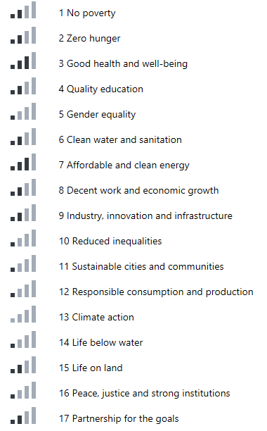

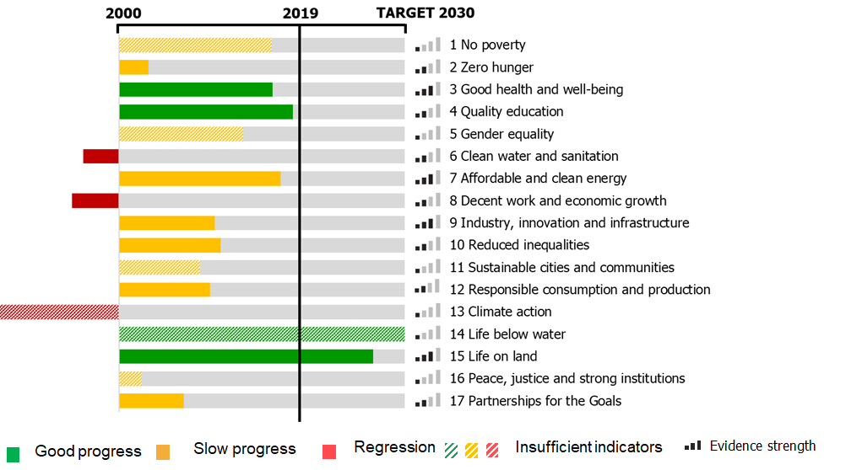
Is Africa on track?
2000
2019
TARGET 2030
1 No poverty
2 Zero Hunger
3 Good health and well-being
Africa is on track on one Goal (SDG14) and made relatively good progress on Goal 10.
Africa cannot achieve any of the other Goals with current pace.
Africa is not moving in the right direction on Goal 16.
Overall data availability is weak for many Goals (Goals 5, 10, 11, 12, 13, 14, 16)
4 Quality education
5 Gender equality
6 Clean water and sanitation
7 Affordable and clean energy
8 Decent work and economic growth
9 Industry, innovation and infrastructure
10 Reduced inequalities
11 Sustainable cities and communities
12 Responsible consumption and production
13 Climate action
14 Life below water
15 Life on land
Contributes to the global methodological developments; DESA, ECA and UNIDO, …
16 Peace, justice and strong institutions
17 Partnerships for the Goals
Good Progress
Slow/Stagnant
Regression
Insufficient data
Evidence strength
Based on data from the UN Global SDG Database

Slide 4
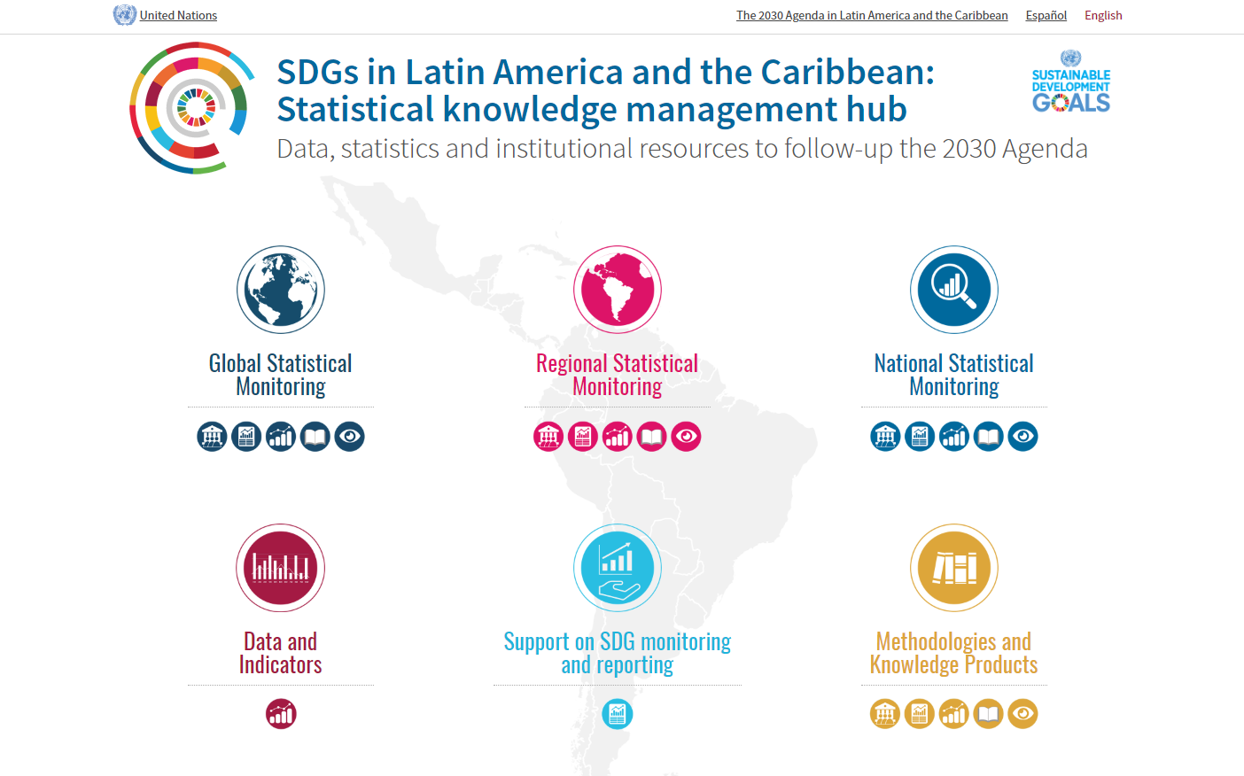
Is Latin America and the Caribbean on track?
LAC region is on track to meet Goals 14 and 15 and making good progress on Goals 4 and 7
There is great concern with regard to regress in Goal 6, 8 and 13
Progress is slow on other Goals.
Data gaps for many of the globally agreed SDG indicators (Goals 1, 5, 11, 13, 14 and 16 in particular)
Based on data from the UN Global SDG Database

Slide 5
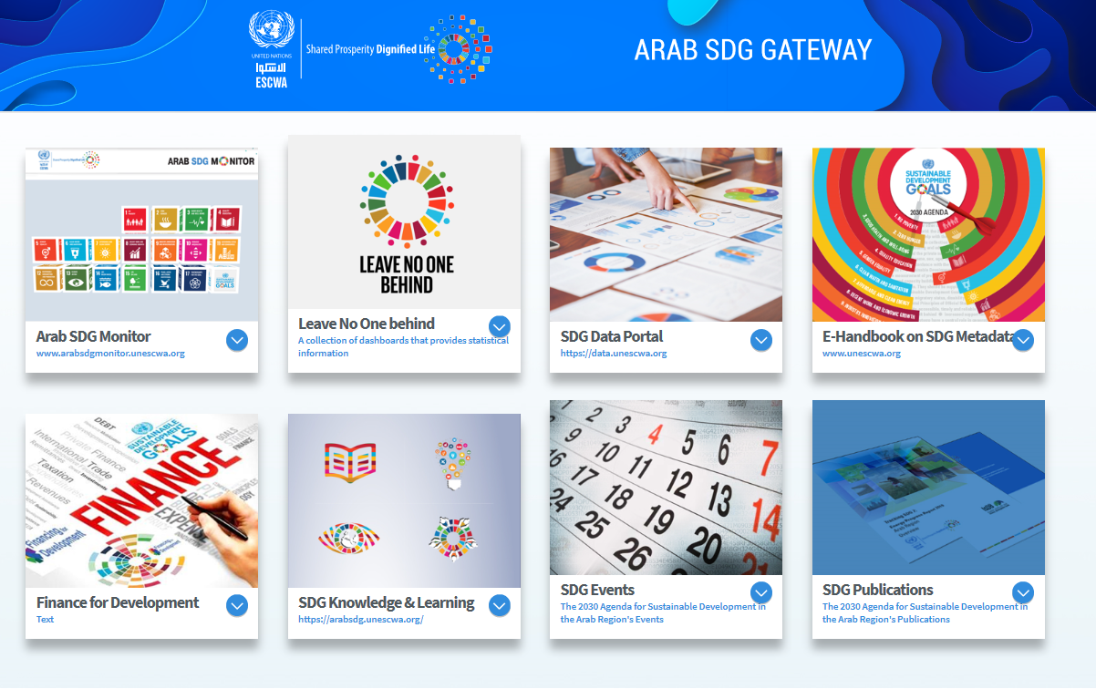

Is the Arab region on track?
2000
2019
TARGET 2030
1 No poverty
2 Zero Hunger
The Arab region is making some progress on Goals 3 and 9
There is great concern with regard to regress in Goal 8
Progress is very slow or stagnant on other Goals.
Strength of evidence overall is weak in many Goals (1, 2, 5, 6, 10, 11, 12, 13, 14, 16, and 17)
3 Good health and well-being
4 Quality education
5 Gender equality
6 Clean water and sanitation
7 Affordable and clean energy
8 Decent work and economic growth
9 Industry, innovation and infrastructure
10 Reduced inequalities
11 Sustainable cities and communities
12 Responsible consumption and production
13 Climate action
14 Life below water
15 Life on land
16 Peace, justice and strong institutions
17 Partnerships for the Goals
Progress
Stagnant
Regression
Insufficient indicators
Evidence strength
Based on data from the UN Global SDG Database

Slide 6
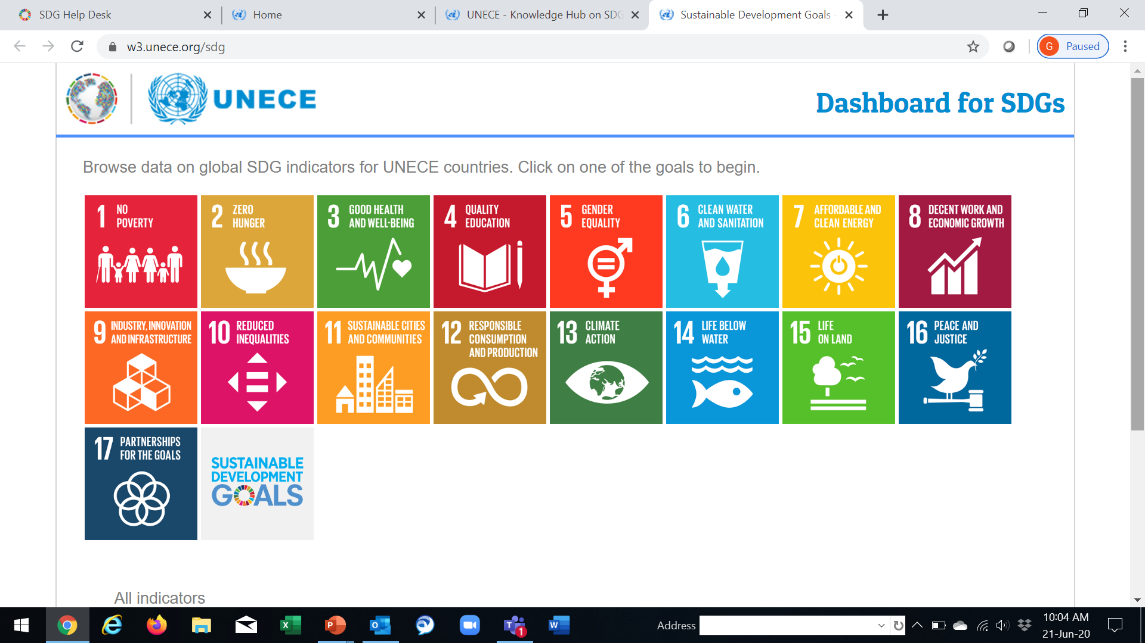
Is the UNECE region on track?
2000
2019
TARGET 2030
1 No poverty
2 Zero Hunger
On 9 goals, the global indicators do not give a strong signal
Of the goals with more data, the UNECE region is
  on track with Clean energy (7)
  close to be on track with Reducing poverty (1), Health (3), and Industry (9);
  and has to catch up on Education (4), Decent work (8), Life on land (15), and Partnerships (17)
3 Good health and well-being
4 Quality education
5 Gender equality
6 Clean water and sanitation
7 Affordable and clean energy
8 Decent work and economic growth
9 Industry, innovation and infrastructure
10 Reduced inequalities
11 Sustainable cities and communities
12 Responsible consumption and production
13 Climate action
14 Life below water
15 Life on land
16 Peace, justice and strong institutions
17 Partnerships for the Goals
Good progress
Slow progress
Regression
Insufficient indicators
Evidence strength
Based on data from the UN Global SDG Database

Slide 7
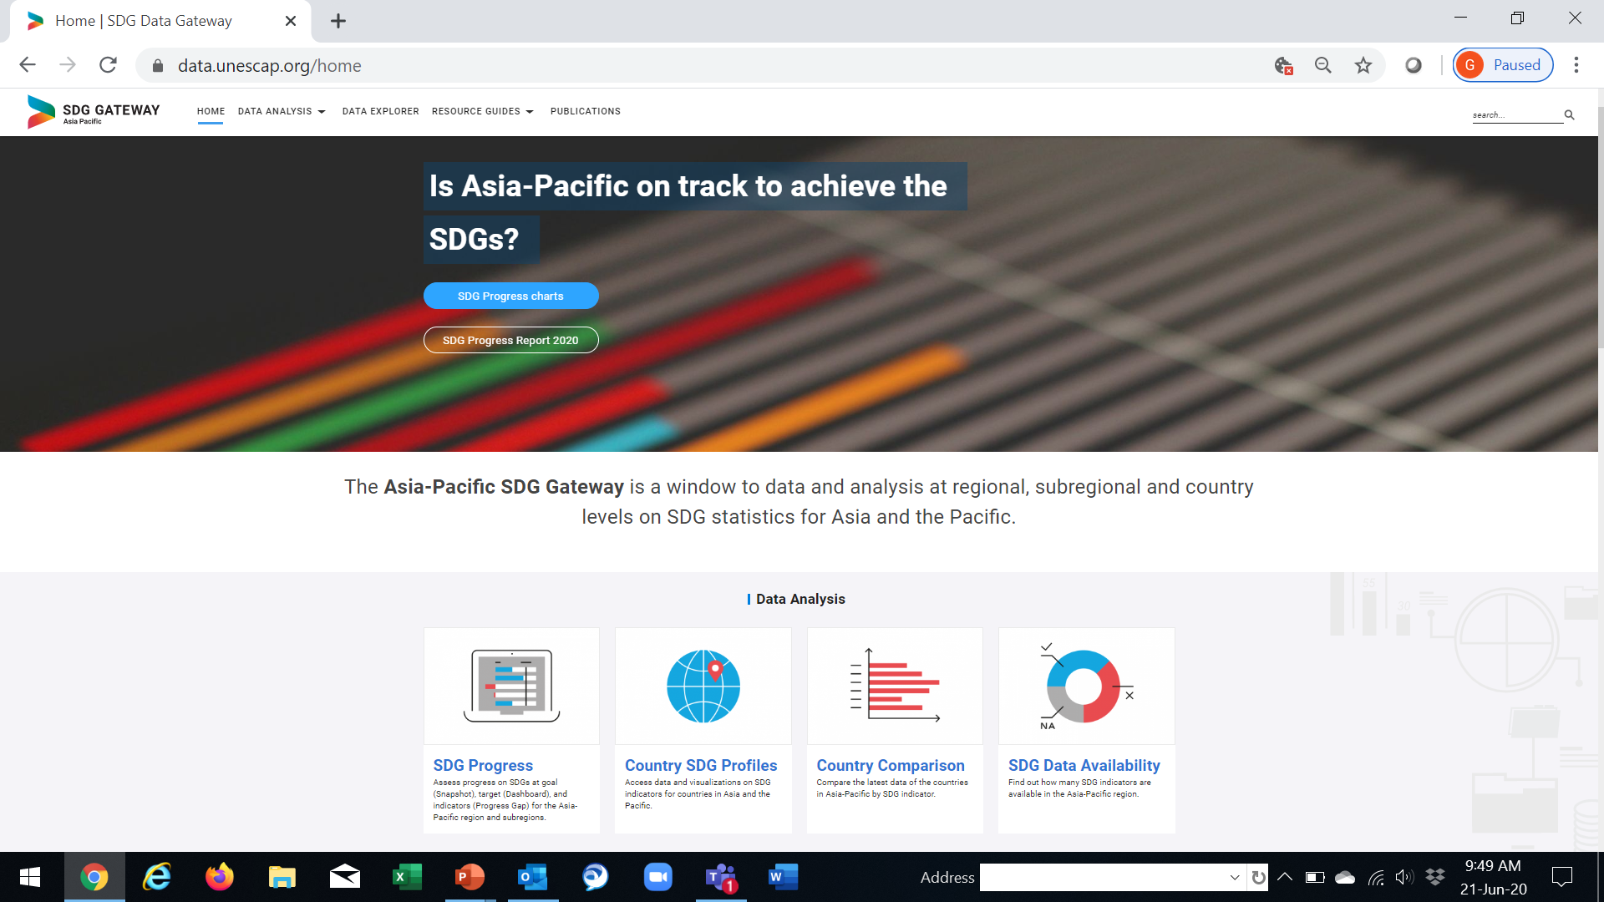

Is Asia and the Pacific on track?
2000
2019
TARGET 2030
1 No poverty
2 Zero Hunger
3 Good health and well-being
Asia-Pacific is not on track to meet any of the Goals, but is making good progress on Goals 4 and 7
Environmental Goals particularly concerning
Data gaps for many of the globally agreed SDG indicators (Goals 11, 12, 13, 14, 16 in particular)
4 Quality education
5 Gender equality
6 Clean water and sanitation
7 Affordable and clean energy
8 Decent work and economic growth
9 Industry, innovation and infrastructure
10 Reduced inequalities
11 Sustainable cities and communities
12 Responsible consumption and production
13 Climate action
14 Life below water
15 Life on land
16 Peace, justice and strong institutions
17 Partnerships for the Goals
Good Progress
Slow/Stagnant
Regression
Insufficient data
Evidence strength
Based on data from the UN Global SDG Database

Slide 8
Thank you

