Slide 1
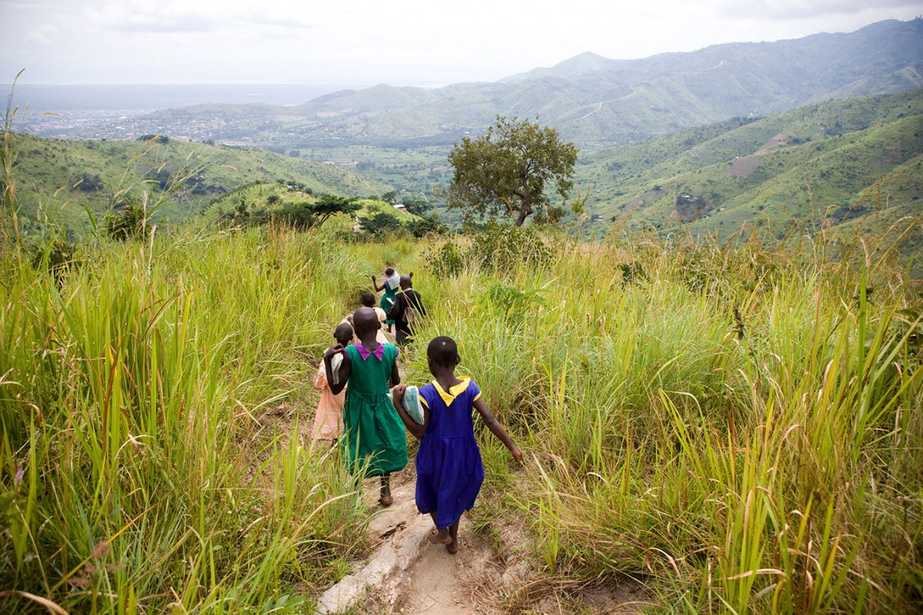
June, 2020
Job Creation from Restoration as a Nature Based Solution
UNDP
BPPS, Nature, Climate and Energy

Slide 2
Triple Win: Nature-Based Solutions to drive economic, social and environmental recovery
Immediate – inclusive daily wage jobs or public works on restoration activities, e.g. ecosystem appropriate restoration, reforestation, non-timber forest produce, removal of invasive species, nursery maintenance, etc (1-12 months)*
Short - and Mid-term – building and strengthening market linkages and supply chains e.g., MSMEs, supporting small holder farmers in adopting climate resilient agricultural practices in farming; (1-5 years)
Long -term – improved social protection, institution building and enable shift in current policies towards a low carbon economy; addressing co-vulnerabilities of social and planetary health, macroeconomic policies resilient to future shocks, incl. natural disasters, climate change (5+ years)
*Important lessons from India’s MNREGS, the largest public works program in the world, with over 80 million participants; defer mechanisation to provide more workforce, where needed

Slide 3
Example from Paraguay – Restoration and forest-friendly agriculture and livestock integration
Grain producing farmers and cattle ranchers could be incentivized to diverge from the business-as-usual production and land-use conversion practices and switch to forest-friendly, low-carbon and climate-resilient practices, through low-interest, long-term and flexible credits. This is particularly important for unemployment labours from cities returning to rural farming.
Why Important
20% of the population is employed in the primary sector; agriculture and livestock
Sector represents 30% of the country’s GDP.
Scale potential (Brazil, Uruguay and Argentina, and potentially in other countries across the world with similar commodities)
What is needed:
incentives (low interest rate loans) for innovative productive practices
increasing resilience of productive systems to climate vulnerability and carbon sequestration.
GHG emission reduction from avoided deforestation and
political will
subsidies’ structures
ability of central, development and commercial banks to blend finance to structure flexible concessional finance
Key features: financial institution partnerships, grain and livestock sectors

Slide 4
Key Overarching Considerations
Ensure that temporary activities are linked to more long-term solution for employment.
Open doors to develop added value activities. It is key to have a clear methodology to identify demand, so we can help shape the products so they can have an output and generate income for communities.
At the macro level, use stimulus packages to rescue industries or economic activities to make catalytic changes. If conditions are tied to the delivery of government grants and loans, a market for sustainable products can be created. For instance, to tie a rescue loan to a hotel by investing in local suppliers of food, etc. (the use of concessional loans in Paraguay are a great example).
Rely on the intelligence from the CO to develop feasible ideas. Market dynamics tend to be different in every single country and for every service or commodity . The green commodities programme has a great amount of experience linking market dynamics with commodities’ production.
Ideas must offer a combination of quick-wins and long-term market linkage strategy, underpinned by a specific set of tools and methodologies to support the materialization of the idea.
The ultimate goal should be to identify interventions that will improve quality and better bargaining conditions, as well as information.

Slide 5
UNDP Integrated Nature, Climate and Energy & COVID-19
PREPARE
RESPOND
RECOVER
Identify and understand risks and opportunities through diagnostics
Provide support to government partners and setbacks in achievement of project objectives.
Prepare for the emergence of zoonic diseases and climate impacts.
Identify opportunities to repurpose harmful fossil fuel subsidies towards nature regenerative and climate resilient activities
Leverage NBSs as an engine for resilience and green job creation
Make evidenced-based public policy and budgetary decisions
Advance ecosystem restoration as a driver of job creation
Strategy and policy for clean, reliable & affordable sources of energy for health facilities
Invest in adaptive social protection by diversifying livelihood opportunities, increasing access to markets, and building resilience within climate sensitive sectors.
Engage/empower citizens, communities, and other stakeholders
Socio-economic assessments to capture interlinked climate and health co-vulnerabilities
Design stimulus packages that support green jobs, work-for-nature schemes
Access to energy to provide social protection and enable food storage and access to public health information
Shift investments and incentives towards SD pathways
Conservation measures to address environmental change and habitat loss
Leverage NDC commitments to drive green job growth

